Slide 1
Lecture 11
Imaging with X-rays
Dr Sarah Bohndiek

Slide 2
Learning Outcomes
After this lecture, you should be able to:
  Describe the development of computed tomography (CT)
  Derive the fundamental equations of CT image formation
  Understand the process of backprojection and its limitations
  Understand the key image quality metrics used in medical imaging and start to apply them to different imaging techniques introduced in the course

Slide 3
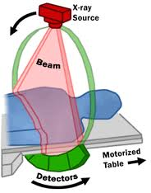
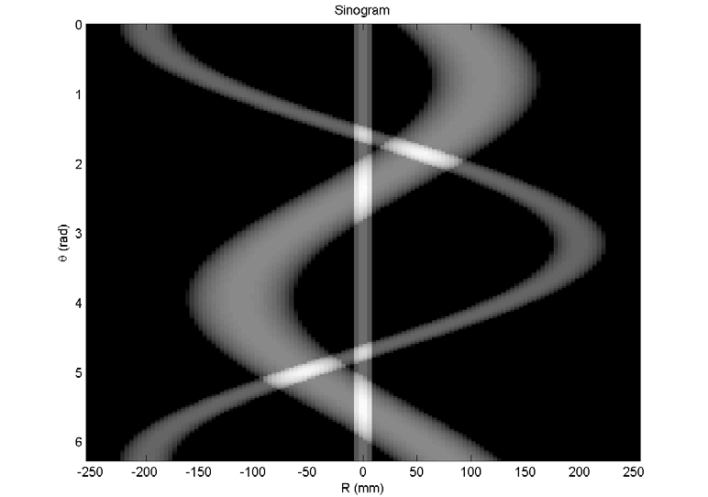
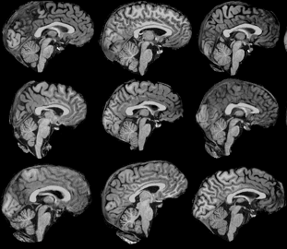
Computed tomography (CT)
Reconstructing the CT image
Methodology for image registration

Slide 4
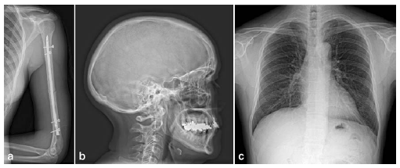
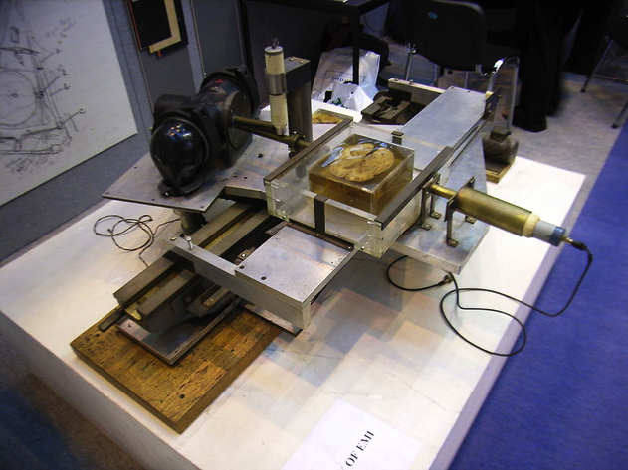
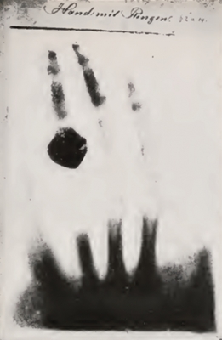
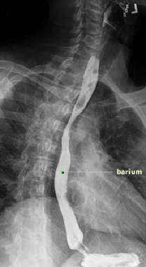
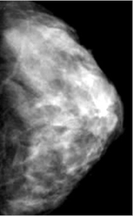
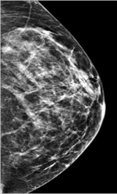
X-ray imaging was the earliest medical imaging technique, dating back to the 1890s
*Nobel prizes (2)
1913
Barkla discovers characteristic X-ray emissions
1971*
Hounsfeld installs first clinically useful CT in London
1990s
Emergence of digital X-ray imaging
1896
First medical X-ray
1895*
Roentgen discovers X-rays
1906
First X-ray of the stomach using bismuth meal
1920s
Fluoroscopy possible with barium meal
1988
UK launches breast screening programme based on mammography
Notes:
Cathode ray tube used, required the discovery of the electron first… Many others had observed the phenomenon but not gone further. New York Times reported this first X-ray as a new form for photography
First patients exhibited dangerous side effects such as hair loss and skin burns, because of the significant doses of radiation that they were exposed to
Widely adopted almost immediately.
Digital sensors emerged with flat panels
Good hard tissue (bone) contrast, poorer for soft tissue but cheap and effective

Slide 5
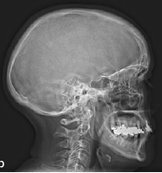
Planar X-ray image formation requires a cascade from incident X-rays to signal electrons
X-ray examination
X-rays
Anti-scatter grid
X-rays
Direct X-ray detector
< 100 keV
< 100 keV
X rays
< 100 keV
Scintillation crystal
Visible light
~ 4 eV
Optical detector
Image
Notes:
X-rays pass through the patient being imaged.
Contrast arises from the photoelectric effect; noise arises from Rayleigh and Compton scatter.
An anti-scatter grid is included so as to prevent too much noise in the image from X-rays that have been scattered in the patient (see next slide).
Diagnostic X-rays can then be detected in one of two ways; either using a direct device (e.g. film, a-Se) or an indirect device, involving conversion of the X-ray into visible light and detection by an optical detector.

Slide 6
The resulting X-ray image is a map of line integrals of the effective X-ray attenuation (bright = attenuating)
I_{d}
μ=0.1
μ=0.2
w=1cm
w=10cm
Transmission of a narrow pencil beam of monoenergetic X-rays with initial intensity I₀ is:
“Projection”
“Line integral through f”
Define

Slide 7
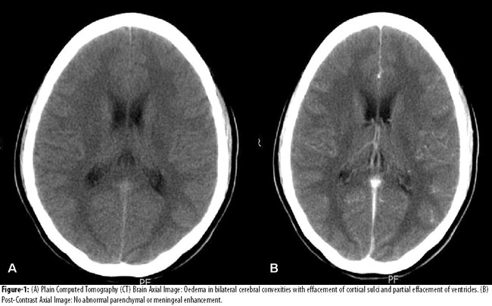
Computed Tomography – Why?
Spann (2005) Eur Radiol (Siemens)
Notes:
In conventional radiology, all information is superimposed into a single plane, which can make it difficult to distinguish structures and also generate geometric distortion of objects in different positions.
The goal of CT is to collect x-ray transmission data from a range of angles about a thin section of the patient, which is reconstructed to form an attenuation map of that slice.

Slide 8
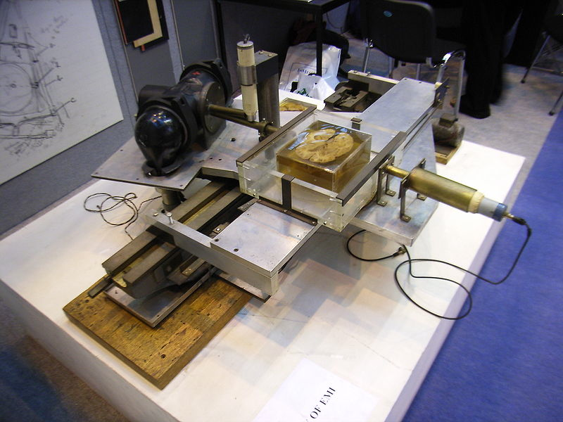
Generation 1: Pencil beam scanning
Notes:
The first clinically useful CT was installed in 1971 by Godfrey Hounsfield of EMI,and the first object imaged by the prototype was a preserved human brain.
Installed in Atkinson Morley Hospital in London, one of the most advanced brain surgery centres in the world at the time.
Hounsfeld shared the Nobel prize in 1979 with Alan Cormack of Tufts

Slide 9
Generation 1: Pencil beam scanning
I
x
1 degree
Photomultiplier tube
> 5 min scan time!
Notes:
Single scanning beam and single detector translate across field of view then rotate by 1 degree and repeat. Known as a “pencil beam scanner”.
In the first device, the patient head was placed in a water bath to provide constant path length of attenuation and reduce effects of beam hardening.
It takes more than 5 minutes to collect a single image. Later devices were waterless, and also included table movement through the gantry to acquire multiple slices.
Conventionally as with planar X-ray we invert contrast so most attenuating objects appear brightest, this goes back to the days of film where the most blackening was obtained by the highest number of penetrating x-rays, so lower attenuation appeared dark and higher attenuation bright.

Slide 10
Generation 2: Hybrid scanning
I
x
Completely separate view for each small angle
Number of translations reduced by 1/ no. detectors
< 0.5 min scan time
Mechanical complexity
< 30 degrees
Notes:
Transmission of multiple narrow beams simultaneously acquired by multiple detectors during each translation (e.g. up to 30 detectors).
Small angle between narrow beams allowed each detector to acquire a completely separate view at a different angle.
Number of required translations reduced by 1/ no. detectors, reduced scan times to less than half a minute.
But further speed improvements were limited by the mechanical complexity of translate / rotate movements

Slide 11
Generation 3: Fan beam geometry
I
x
Completely separate view for each small angle
Number of translations reduced by 1/ no. detectors
Pure rotational motion so reduced mechanical complexity
< 5 s scan time
Divergence of beam must be accounted for
Notes:
Detector array of up to 800 detectors rigidly linked to x-ray tube, rotate as one unit
Pure rotational motion allows scan times less than 5 s, some now as fast as half a second.
Remains the basic geometry of most CT scanners manufactured today

Slide 12
Generation 4: Fan beam, fixed ring
Large stationary ring of detectors
Pure rotational motion of X-ray tube alone so reduced mechanical complexity
< 1s scan time
Typically need 1000s of detectors leading to high cost
Notes:
1s scan time and below obtained using a large stationary ring of detectors with the x-ray tube alone rotating around the patient.
Developed in parallel with and partly in response to engineering challenges of 3rd gen.
Typically need 1000s of detectors so disadvantages quite substantial in terms of cost, 3rd gen actually preferred.

Slide 13
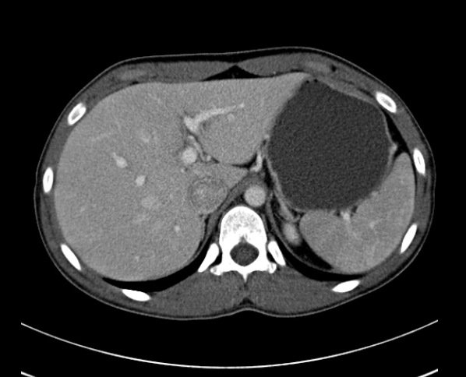
Defining the scale: what does a CT slice image represent?
-987 HU
12 HU
142 HU
1010 HU
Notes:
CT number relates the image grayscale intensity to the attenuation of water.
K = 500 in the original EMI CT scaling and typically 1000 is now typically used, so +1000 represents bone and -1000 represents air and 0 is water.
The HU of different tissues is determined by their density and atomic number, as contrast is given by the photoelectric effect

Slide 14
CT number for common tissues
Material | CT number (HU)
Air | -1000
Fat | -120 to -40
Water | 0 (by definition)
Muscle | +10 to +40
Soft Tissue | +30 to +60
Bone | +1000 to 3000

Slide 15
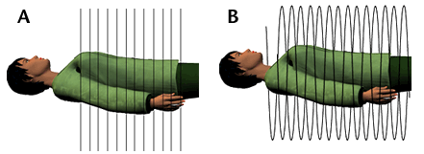
Building up volumetric information quickly: spiral CT
http://imaging.cancer.gov/patientsandproviders/cancerimaging/ctscans
Notes:
By the late 1980s, CT exam times were dominated by interscan delay, where cables connecting rotating components to the rest of the gantry meant that the rotation had to stop and reverse direction at the end of a scan, which required at least 10s.
Eliminating this delay would require continuous rotation. Strategy = continuously rotate and acquire data.
Achieved by 1) slip rings to pass electrical power to rotating components (like conductive ceiling for bumper cars) so can do multislice CT with repeated axial views. Then to increase speed further 2) the patient is moved through the gantry tracing out a spiral path.
More tricky to reconstruct and must carefully define the pitch of the spiral. Not truly 3D like MRI, a combination of axial slices.
All third generation fan beam scanners operate in both axial and helical modes.

Slide 16
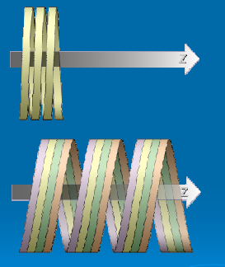
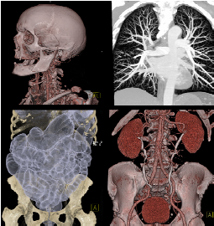
Even faster with multi-slice spiral CT
Single slice = limited scan coverage per rotation
Multi slice = increased scan coverage per rotation: >128 slices in < 0.3 s!
Kalendar (2006) Phys Med Biol R29
Notes:
More coverage per rotation, thinner slice reconstruction meaning higher resolution in z axis.
Latest scanners have multiple parallel rows of detectors so that up to 128 consecutive slices can be imaged with one tube rotation of under 0.3 second
Large volumes can be scanned very rapidly at the expense of the z resolution

Slide 17
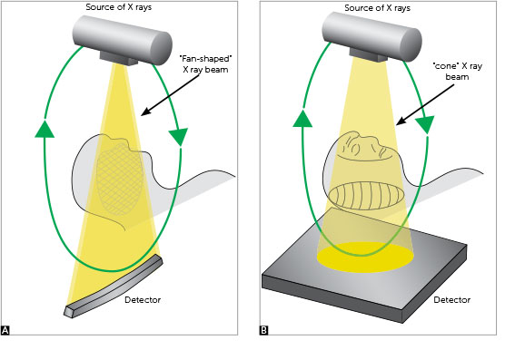
Multi-slice spiral CT is achieved using a cone beam
da Silva (2013) J Orthodontics
Notes:
Now a 2D flat panel detector, like those in conventional radiography, is used, which allows a single rotation of the gantry to generate a scan the size of the entire head.
More efficient use of the generated X-rays (which are normally collimated to create a fan beam), which means a lower tube heat capacity needed, for the same source and detector geometry the efficiency scales roughly with slice thickness.
Modern CT can get 320 slice, 16 cm coverage image in under 0.3 seconds (well, relatively modern, quoted numbers from 2008).
This technology now enables CT fluoroscopy, or live imaging, with frame rates around 5 fps.
To go faster, dual source CT has been introduced to overcome cardiac motion – we effectively double up the gantry and use two source / detector banks. This is the current state of the art in computed tomography.

Slide 18
Summary 1: Basics of CT
Computed tomography uses X-ray attenuation to create virtual slices through an object
Projections must be acquired and reconstructed
Modern CT systems can take scans that cover 100s of slices over 10s of cm in less than 0.5 seconds
  Very high throughput

Slide 19
Computed tomography (CT)
Reconstructing the CT image
Methodology for image registration

Slide 20
Reminder: Contrast describes the potential to delineate multiple objects within an image
Contrast
I₀
Contrast-to-noise ratio
I₁
I₂
Notes:
Ideally only shot noise that will limit our ability to distinguish objects in an image.
The contrast in a digital image is the absolute difference of two objects in terms of pixel value.
I1 and I2 represent the mean numbers of photons in two different regions of the image, S refers to the pixel values recorded for those regions.
Contrast to noise ratio is more meaningful in digital images as it describes the contrast potential – given the inherent noise limitations of the detector in terms of residual readout and fixed pattern noise that we are unable to correct, what is the potential contrast that can be obtained between two objects in an image.

Slide 21
There are two key challenges with using projection-based (planar) imaging systems
y
μ=0.1
μ=0.2
w=1cm
I_{d}
w=10cm
Inherent contrast
Projection intensity
Recorded contrast
Notes:
No depth (z) information available in the projection, so you cannot tell where along the line the lesion is located.
Large changes in linear attenuation coefficient in the object produce relatively small changes in image intensity.
Same goes in nuclear medicine, except in that case we have a source within the patient.

Slide 22
Computed Tomography (CT) in any modality is the key to overcoming these limitations
Side view
Top view
Define
“Projection”
“Line integral through µ”

Slide 23
The key to performing Computed Tomography (CT) in any imaging modality is the ‘Central Slice Theorem’
y
R
Instead of μ(x,y), we consider some arbitrary f(x,y) and its projection g(R), rewriting g(y) as:
x
f(x,y)
g(R)
(where y = R is the line along which integration is to be performed.)
By using this more general form, we can now describe a line integral at an arbitrary angle, θ…
Notes:
y=R defines a line along which the integration is to be performed

Slide 24
The key to performing Computed Tomography (CT) in any imaging modality is the ‘Central Slice Theorem’
y
f(x,y)
At an arbitrary angle, θ:
θ
x
g(R)
R
This collection of projections over a range of angles θ is known as the Radon transform of f(x,y)
New line
The Central Slice Theorem states:
The 1D FT of a projection g_{θ}(R) is the 2D FT of f(x,y) evaluated at angle θ

Slide 25
The key to performing Computed Tomography (CT) in any imaging modality is the ‘Central Slice Theorem’
The Central Slice Theorem states:
The 1D FT of a projection g_{θ}(R) is the 2D FT of f(x,y) evaluated at angle θ
Comparing to the 2D FT of f(x,y):
Hence to make a tomographic image, we:
acquire projections at many angles over 0 to π to capture the F(u,v) space
inverse 2D FT to find f(x,y)
Notes:
In polar coordinates rho cos theta = x etc

Slide 26
All projection data are referred to as a Radon Transform and the visual representation is a sinogram
For example, taking a point object at x₀, y₀
If y₀=0 then the projection is a delta function located at x₀cosθ
0
0
R
g_{θ}(R)
The sinogram is also known as Radon Space
R=x₀cosθ
π
θ
Notes:
i.e. a point that traces out a sinusoid in the R-θ space and hence the name sinogram.

Slide 27
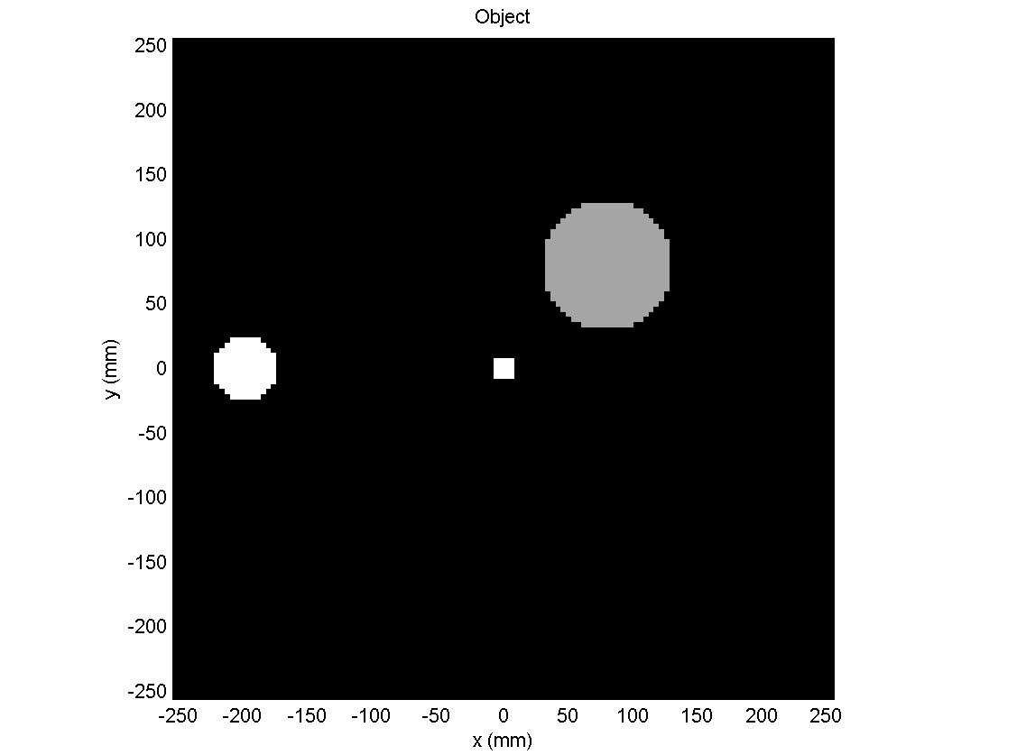
All projection data is referred to as a Radon Transform and the visual representation is a sinogram
Angle of projection
Position in projection
Z axis = intensity of projection

Slide 28
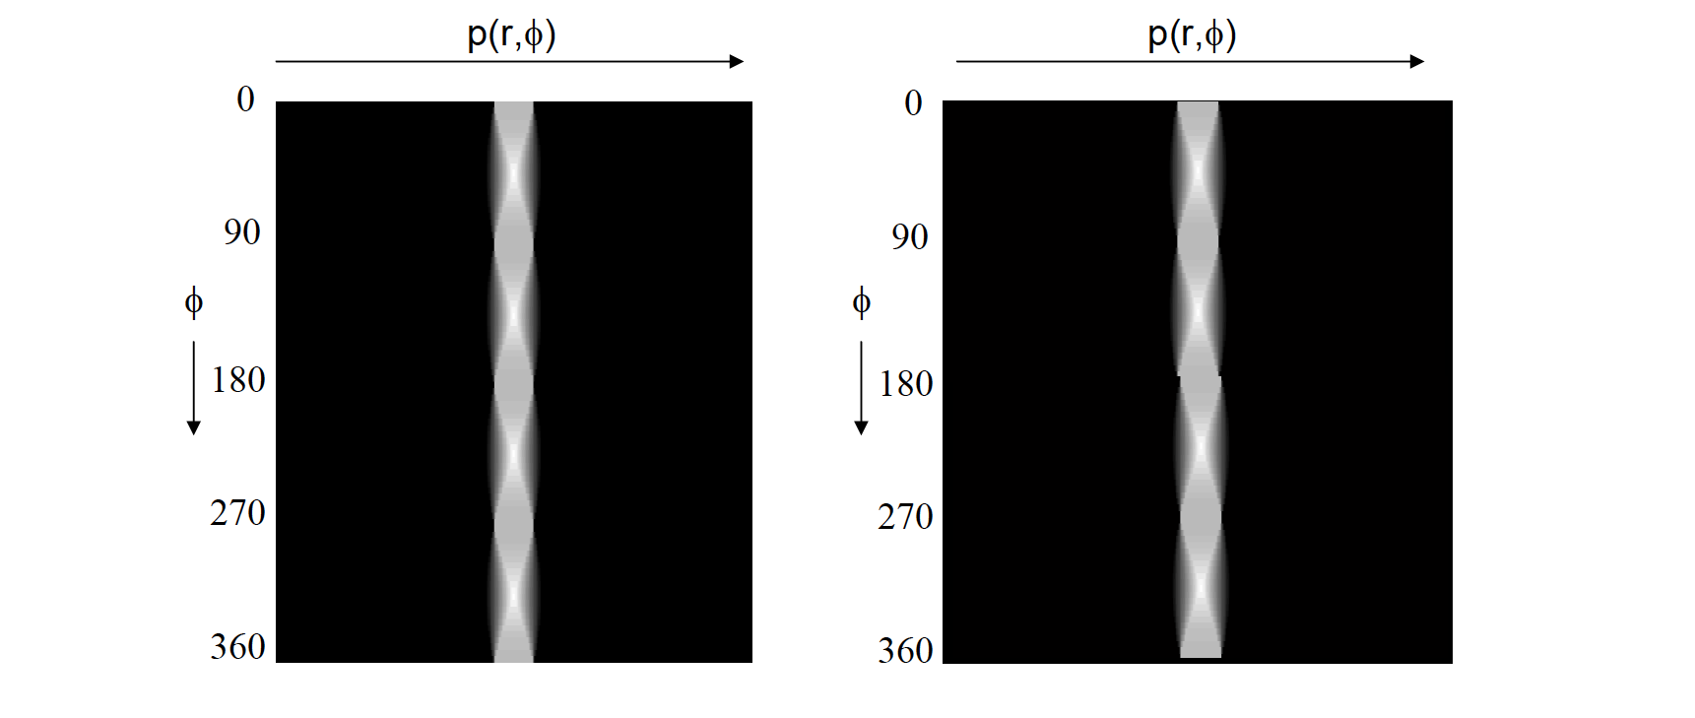
Asymmetry and noise in the sinogram can diagnose problems with our imaging system
Notes:
Sinograms are powerful for detecting errors in the scan, for example, here you can see a motion artifact

Slide 29
To recover f(x,y) from its projections we need to fully sample the Fourier transform
For all non zero points F(u,v)
  Complete sampling is achieved if non-truncated projections are acquired for 0 to π
Geometries that satisfy this angular sampling include
  Rotating X-ray tube and detectors
  Rotating gamma camera (SPECT)
  Ring of detectors (PET, more next time)
Note that the sampling density is not uniform in fourier space (=1/u,1/v)
  This has to be corrected for otherwise the image is dominated by low spatial frequencies (see MTF later)
Notes:
Image reconstruction from a set of projections is a classic inverse problem. There are many ways to solve it but we will focus on backprojection.

Slide 30
The fact that we sample in discrete steps with noisy instruments places additional constraints
So far, we have assumed perfect line integrals and infinite, continuous spaces.
In practice the object space is sampled, e.g. at intervals of Δx.
Shannon sampling theorem states that the maximum frequency that can be recovered without aliasing is
Aim for sampling ≈ 1/3 spatial resolution FWHM.
Uncorrelated noise is flat in frequency space, but true signal is attenuated at high frequencies because of the limited spatial resolution.
the Nyquist frequency

Slide 31
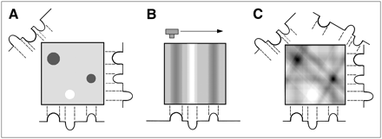
Reconstructing the slice by back projection
0
3
0
0
0
3
3
0
0
0
0
2
0
1
0
0
0
3
3
3
2
4
2
3
3
3
3
1
2
1
3
1
0
0
0
2
0
0
1
0
0
3
0
0
0
0
3
3
3
0
0
0
3
0
0
Goldman (2007) J Nucl Med Technol
Notes:
Given the CT geometry shown earlier, how can we reconstruct the images? Let’s consider a point object imaged from 4 angles. If we simply smear the recorded slice profile back across the slice area, we can recapitulate something that looks quite similar to our original image, with some additional blur.
We can see a simple phantom containing 3 objects with different attenuation values and the slice profiles recorded at different angles.
For each view, attenuation values are simply divided evenly along their ray paths
(c) Illustrates how summing backprojected views from several angles builds image. Here, four views of the phantom are summed.
Although the method is computationally efficient and even with a few projections can reconstruct the presence of the test objects, the images reconstructed with standard back projection exhibit considerable blurriness.
For these cylinders, the nature of x-ray attenuation means that maximum attenuation will occur in the middle and less towards the edges (scan blur), and backprojecting smears out the contrast (BP blur).

Slide 32
A simple backprojection is the object space equivalent of placing a central slice in Fourier space
The counts in a particular projection element are back projected uniformly along the pixels in its projection path in the image matrix
This is repeated for all projection angles to give an approximation to the true distribution, but counts are recorded outside the true location
As the number of projections increases, the spoke artifact becomes just a blur around the object

Slide 33
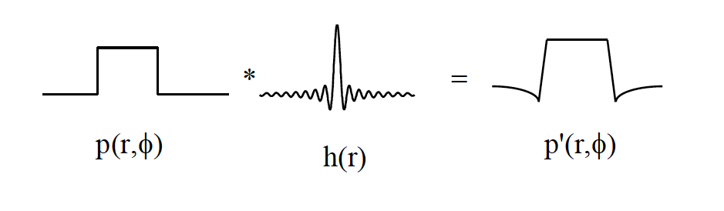
By applying a filter before back projection, the blurring effects can be reduced
“Star artifact” in the reconstructed image
Minimised by the negative lobe in the filtered projection

Slide 34
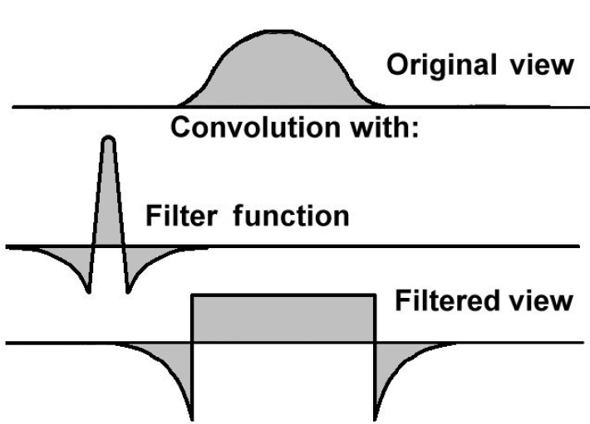
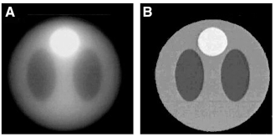
By applying a filter before back projection, the blurring effects can be reduced
Amplitude
Goldman (2007) J Nucl Med Technol
Spatial frequency, k
Notes:
Simple backprojection causes a 1/r blurring i.e. in the spatial frequency domain, it behaves like a filter that decreases linearly with frequency (high frequencies are suppressed)
By applying a known filter to the profiles before backprojecting, the blurring effects of simple back projection can be cancelled
A ramp filter that increases with spatial frequency k can compensate.
In real space, the profiles are convolved with the filter kernel, the choice of which will affect the final image quality. We perform all manipulations in Fourier space so we can simply multiply rather than convolve.
Filtering is applied to each view before backprojection in Fourier space.

Slide 35
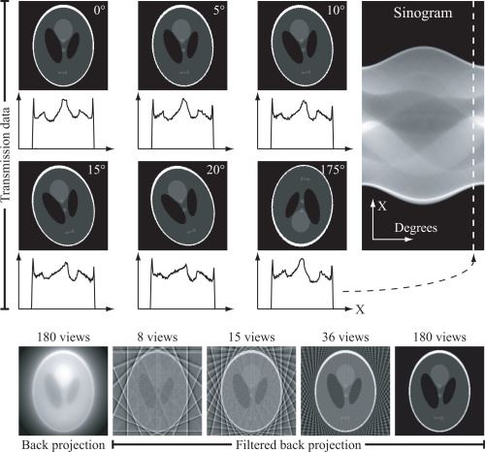
By applying a filter before back projection, the blurring effects can be reduced
Kristensson et al (2012) Opt. Express
Notes:
Sampling at 6 different viewing angles, composed sinogram and reconstruction with and without filtering.
Note the phantom is a Shepp-Logan “head phantom” which is computationally used to test new imaging techniques.
Sinogram was built from 180 views.

Slide 36
CT results in improved contrast compared to planar X-ray imaging
I_{d}
μ=0.1
μ=0.2
w=1cm
w=10cm
Projection contrast
CT contrast

Slide 37
Summary 2: Tomographic reconstruction
Tomographic reconstructions rely on the Central Slice Theorem
  The 1D FT of a projection g_{θ}(R) is the 2D FT of f(x,y) evaluated at angle θ
A sinogram is a visual representation of all of the collected projections (the ‘radon transform’)
Backprojection is the simplest reconstruction method with which to create a 2D slice image from a radon transform
  Increasing the number of projections blurs out spoke artifacts
  Applying filters can reduces the blurring

Slide 38
Computed tomography (CT)
Reconstructing the CT image
Methodology for image registration

Slide 39
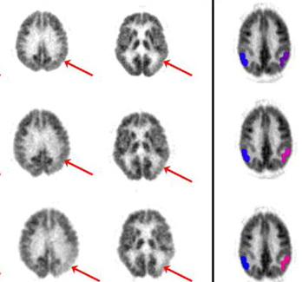
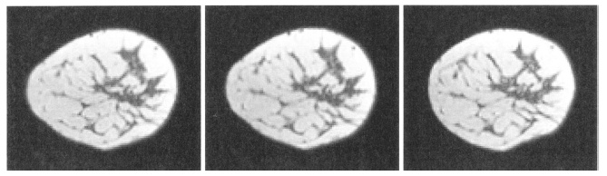
Why register medical images?
[¹⁸F]FDG PET for the evaluation of cognitive dysfunction
(Silverman et al (2008), Sem. Nuc. Med., 38(4): 251-261)
MRI and [¹¹C]PK11195 PET imaging of inflammation 10 days after stroke
(Price et al (2006), Stroke, 37: 1749-1753)
Before Motion
After Motion
Non-rigid registration
MRI in breast carcinoma
(Rueckert D et al (1999), IEEE Trans. Med. Imag, 18(8): 712-721)
Courtesy Dr Tim Fryer, WBIC
Notes:
Compare information from multiple different imaging modalities e.g. comparing anatomical and molecular information in MRI and PET for identification of inflammatory processes after stroke
Compare information from the same imaging modality acquired over time e.g. monitoring cognitive decline in a patient
Compensate for patient motion e.g. co-registration of adjacent slices acquired in breast MRI that have been distorted by motion

Slide 40
A range of different images can be registered
Longitudinal (serial) or dynamic (within scan) imaging
Intra-subject
Intra-modality
Normalisation and registration to atlas/template
Image fusion
Inter-subject
Inter-modality
Courtesy Dr Tim Fryer, WBIC
Notes:
Intra-subject registration corrections for positional variations between imaging sessions or subject motion within a single session
Comparing many subjects scanned using the same imaging modality, for example in a population comparison study, requires comparison of each individual subject to a chosen template for the organ of interest
Data from several modalities for the same subject may require an image fusion, so that all data can be displayed simultaneously for interpretation

Slide 41
The aim of image registration is to find a spatial relationship between homologous features
Given a reference image A and a moving image B, find a reasonable spatial transformation T, so that B(T) aligns with A
A
B
x_{A}
T
x_{B}
Reference Image
Moving Image
Register
B to A
Courtesy Dr Tim Fryer, WBIC
Image A
Image B
Notes:
Note that image registration is an ill-posed problem
We are seeking a geometrical transformation for every spatial location given intensity information only
This means that different registration solutions are obtained for the same problem under different transformation models, similarity functions, regularisation methods and optimisation algorithms

Slide 42
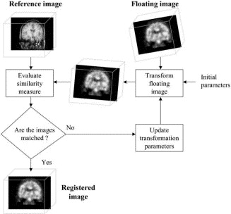
Image registration uses a transformation model, similarity metric and numerical optimisation
Transformation Model
  How can one image be transformed onto another (spatial relationship)
Image Similarity Metric
  Determine similarity between images (accuracy of spatial correspondence)
Numerical Optimisation
  Search for transformation (under model assumptions) that maximises similarity
Hutton BF and Braun M (2003), Sem. Nuc. Med., 33(3): 180-192

Slide 43
Types of transformation models
Courtesy Dr Tim Fryer, WBIC
Rigid
T(x) = Rx+t
Rotations (R) and Translations (t)
Invariants: Distances (isometric), angles, parallelism
Similitude or Similarity*
T(x) = sRx+t
Scaling factor s
Invariants: Distance ratios, angles, parallelism
y
Original Object
Affine
T(x) = Bx+t
Matrix B includes rotations, shears and scaling factors
Invariants: parallelism
x
Non-rigid or Deformable
T(x) = x+u(x)
Displacement u(x) for each pixel/voxel
*not to be confused with the image similarity metric
Notes:
The transformation model is a geometric relationship between corresponding positions in the reference and moving images
Describes “how” and by “how much” a point in the moving image needs to be “moved” to align with its corresponding point in the reference image
For deformable anatomies, rotations, translations, scaling and shears do not suffice. We need to deal with deformation of organs (intra-subject) or variability in shape, size or function of organs (inter-subject) so more flexible transformations, i.e. with a larger number of degrees of freedom, are needed

Slide 44
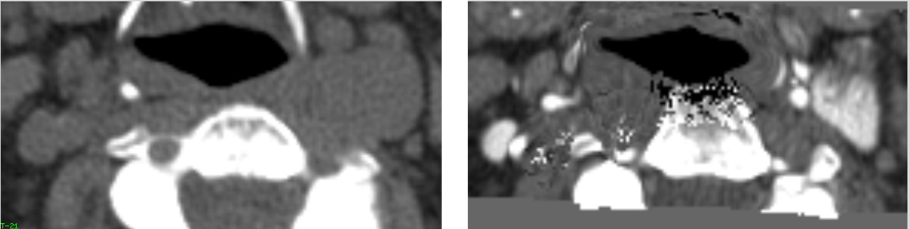
A reasonable transformation means that deformations should be physically realistic
“Folding” and/or “Inversion” of features
Transformation model should be flexible
“Tearing” of features
Regularisation
“Holes”
Transformation restricted to prevent…
Disintegration of structures
Deformations should be physically realistic and/or topology preserving
Not Allowed
Courtesy Dr Tim Fryer, WBIC
Notes:
An example of topology disintegration in a neck CT is shown at the bottom
Regularisation may be done implicitly e.g. in parametric registration, by placing restrictions on low dimensional space or explicitly, for example by adding a penalty term in physical models that include a priori information about the properties of anatomical structures

Slide 45
Transformation alone is not enough, we need to establish correspondence (alignment) of the images
Similarity ≈ “Likeness” Visual Resemblance
Image Similarity
Geometry & Structure
Shape, size and spatial relationships between features
Texture
Colour and intensity characteristics of features
Why is Image Similarity important for Image Registration?
Basis for comparison Measure of correspondence (alignment)
Measures the accuracy of the transformation
Courtesy Dr Tim Fryer, WBIC
Notes:
Image similarity metrics may be:
Intensity-based – compare or correlate intensity patterns in images
Feature-based – enable correspondence between geometrical features e.g. points, lines and contours
Or a combination of the two
Voxel similarity measures may be statistical (e.g. sum of squared differences, cross correlation) or information-theoretic (joint entropy, mutual information)

Slide 46
Feature-based image similarity may use landmarks or surfaces to enable registration
Landmarks (point-sets)
  Intrinsic - anatomical landmarks or point-like structures
  Extrinsic – external markers visible on each image
Point-sets
q
p
Proximity of corresponding point features
Image similarity = -∑(Distance between points)²
Image registration problem
=
Minimise sum of squared distance between points
Image A
Image B
Courtesy Dr Tim Fryer, WBIC
S: Image similarity; q, p: sets of points in images A and B; T: transformation
Notes:
Surfaces can be used because we can perform feature extraction by means of segmentation of a region of the image. The segmentation of a target organ may be manual or automatic and usually identifies feature boundaries. From the segmentation, a contour is defined that provides a collection of points around a surface as our point-set.
Problems with feature-based similarity are the potential ambiguous or inaccurate identification of landmarks or segmentation errors in surfaces.

Slide 47

Intensity-based image similarity metrics may measure the degree of shared intensity information
Similarity = the degree of shared intensity information between images
Measure of information → measure of similarity
In alignment
One set of features
Out of alignment
Duplicate sets of features, i.e. 2 sets of eyes etc.
For image registration:
Minimise the amount of information in the combined image
Courtesy Dr Tim Fryer, WBIC

Slide 48
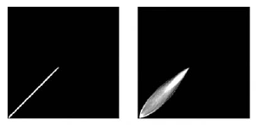
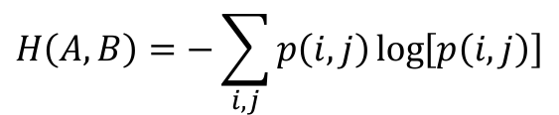
Several information-theoretic similarity measures may be used
Joint Entropy
Image B
Image B
$$H\left(A,B\right)=−\sum_{i,j}{p\left(i,j\right)\log\left[p\left(i,j\right)\right]}$$
Image A
Image A
i,j: events, p_{i} probability of event i\
For similarity:
Minimise the dispersion in joint histogram
(joint probability distribution)
In alignment
Translation: 2mm
Mutual Information
For similarity:
Maximise the mutual information
(reference image is the best possible predictor of the correct outcome)
$$I\left(A,B\right)=H\left(A\right)+H\left(B\right)−H\left(A,B\right)$$
Courtesy Dr Tim Fryer, WBIC
Notes:
Joint entropy gives a measure of the amount of information in the combined image only
Mutual information considers the information in each image as well as that of the combined image

Slide 49
Numerical optimisation allows for fine adjustment of the transformation to improve similarity
Image Registration is an Optimisation problem
Adjust transformation → Improve similarity between images
[find transformation [Similarity becomes maximum] parameters]
Optimisation Algorithms
Gradient Descent (GD)
Conjugate Gradient Descent (CGD)
Powell’s Downhill Method
Levenberg-Marquardt
Simplex Method
Courtesy Dr Tim Fryer, WBIC

Slide 50
Summary 3: Image registration
Image registration allows us to compare images acquired from different subjects, modalities and time points
To achieve registration we must combine:
  A transformation model to describe the spatial relationship
  A similarity metric to determine homology
  A numerical optimisation to maximise similarity
Models may be rigid, affine, similar, deformable and must preserve topology through regularisation

Slide 51
Computed tomography (CT)
Reconstructing the CT image
Methodology for image registration

