Slide 1
Lecture 7:
Ultrasound Applications and Safety
Dr Sarah Bohndiek

Slide 2
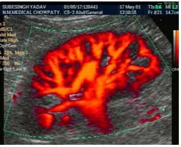
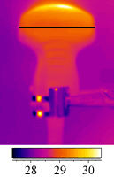
Ultrasound Applications
Ultrasound Safety and Standardisation

Slide 3
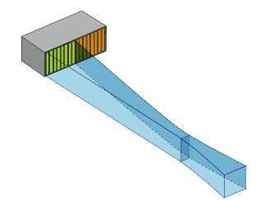
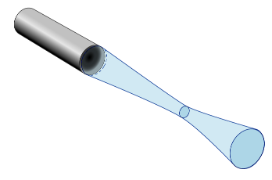
Transducer arrays can be used to build up B-mode images
1D Linear: Enables beam steering; can be unfocused or focus in one axis
2D Square: Spherical or single axis focus, imaging in 3D, more complex design and manufacturing
Notes:
1D mechanical scanning of a single transducer element can be used to create a B-mode image
Linear arrays of transducers are now far more comment; note that the rectangular aperture of the linear array components produces a beam with a non-circular cross-section, so the focal beam width in the vertical (elevation) plane is wider than the horizontal (scan) plane
In a linear array, we typically have 256 – 512 discrete transducer elements, grouped into 15 – 20 adjacent elements that are activated simultaneously and then sequential groups are pulsed.
The reason for the grouping is that small transducers, as we saw previously, produce a short near field and large crystals give poorer line spacing so compromise by making a larger effective transducer size with grouping.

Slide 4
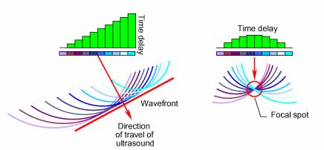
Transducer arrays have the added advantage of enabling directionality and focusing
http://www.olympus-ims.com/en/ndt-tutorials/transducers/
Notes:
By activating all groups at the same time but introducing a time delay between pulsing of the groups we can generate an angled wavefront for beam steering (planar) or we can focus. this is approach is called phased array ultrasound.
The slice thickness (or “elevational resolution”) depends on the transducer element height, so we can develop a 3D imaging array by extending the transducer into two dimensions

Slide 5
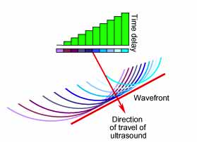
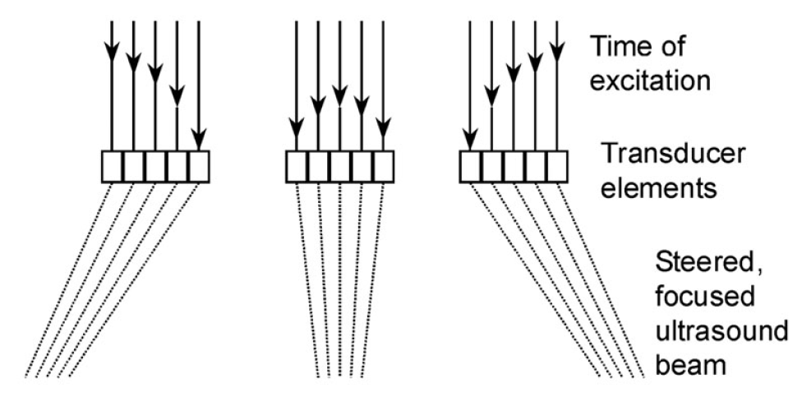
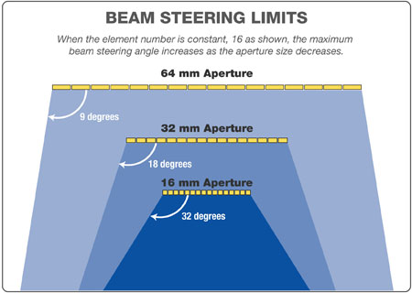
Phased arrays enable electronic beam steering, removing mechanical complexity
http://www.olympus-ims.com/en/ndt-tutorials/transducers/

Slide 6
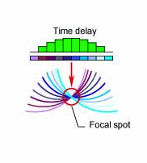
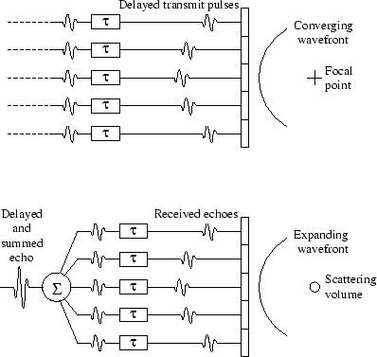
Phased arrays enable beamforming (focusing) on the transmit or receive signals
http://dukemil.egr.duke.edu/Ultrasound/k-space/node2.html
Notes:
The transmit signals passing to, and the received signals passing from, the array elements can be individually delayed in time, hence the term phased array.
This is done to electronically steer and focus each of a sequence of acoustic pulses through the plane or volume to be imaged in the body.
Beamforming refers to the process of steering and focusing these acoustic pulses.
It is possible because the transducer on the far left / right are actually further from the object than the central one so nanosecond pulse delays allow the wavefronts to arrive simultaneously at the object.
We can also perform this retrospectively on reception of the signals and use multiple focal zones, at the expense of imaging speed.
Advantage is that the focus is no longer hard coded by the piezo element geometry, can adjust over time

Slide 7
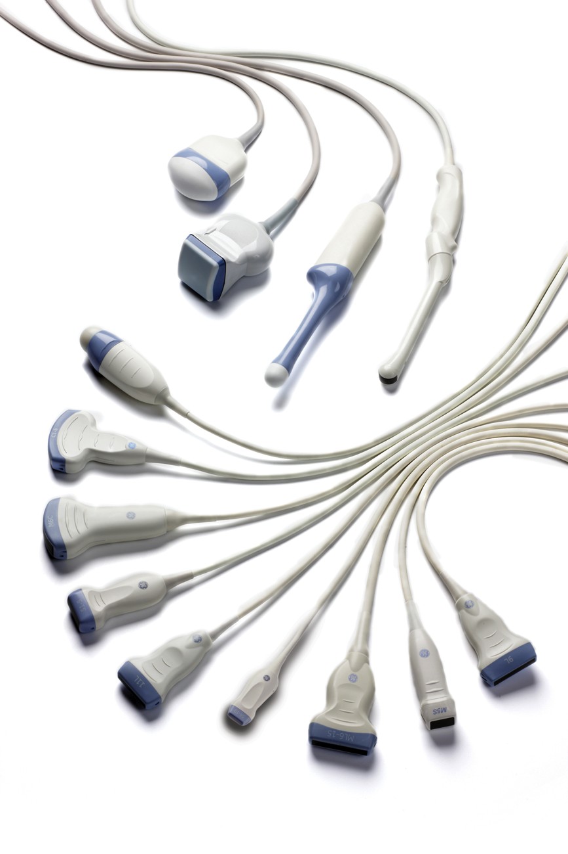
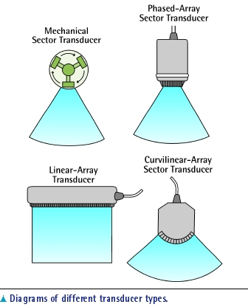
Several different scanning geometries can be employed
GE Healthcare

Slide 8
Ultrasound is a very versatile technology with many imaging modes
B mode (2D/3D/4D imaging)
Tissue harmonic imaging
Doppler imaging
M mode
Contrast enhanced imaging
… and many more

Slide 9
B mode

Slide 10
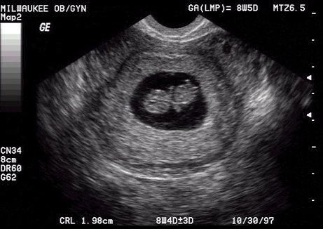
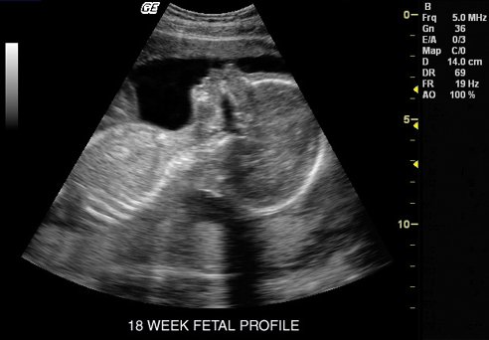
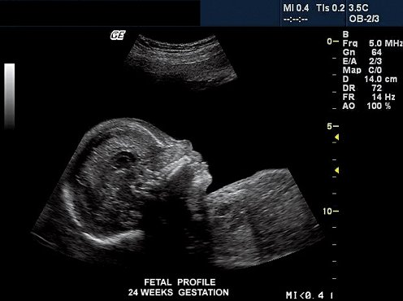
Using B-mode to monitor pregnancy
8 weeks gestation (out of a 40 week pregnancy)
18 weeks
24 weeks

Slide 11
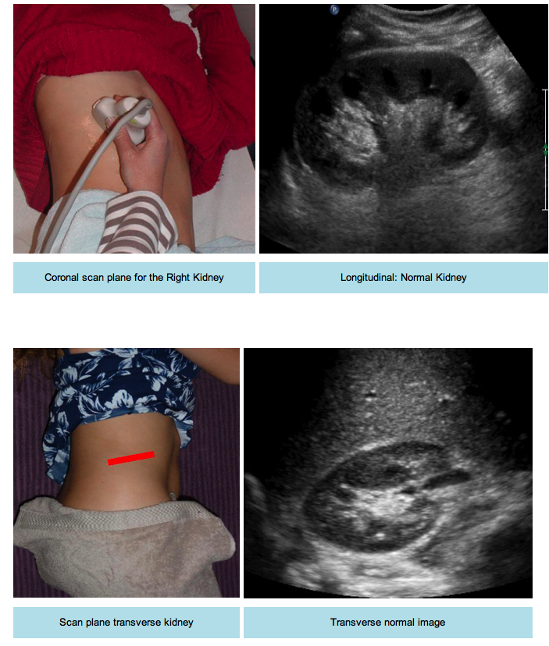

Slide 14
B-mode artefacts arise from a number of sources
Speckle
Reflections (reverberation and mirror images)
Refraction
Attenuation (shadowing and enhancement)
Side lobes and grating lobes
Speed of sound errors
Resolution artefacts & range ambiguity
Nice lecture overview: https://radiology.uchicago.edu/sites/radiology.uchicago.edu/files/uploads/Lectures/1505012_UCCME%20Radiology_Review.pdf
Notes:
An artefact is defined as a false echo signal in the image of the scanned medium created by the inherent nature of sound interactions, equipment malfunction or misuse of equipment.
Four main assumptions in ultrasound image acquisition that can be broken are: speed of sound is constant at 1540ms-1; attenuation in tissue is 0.5 dB MHz-1 cm-1; the beam axis of the ultrasound pulse is in a straight line; and the ultrasound pulse only travels to targets along the beam axis and back to the transducer. In reality, breaking these assumptions leads to artefacts.
Experience and good knowledge of anatomy allow most artefacts to be recognised.

Slide 15

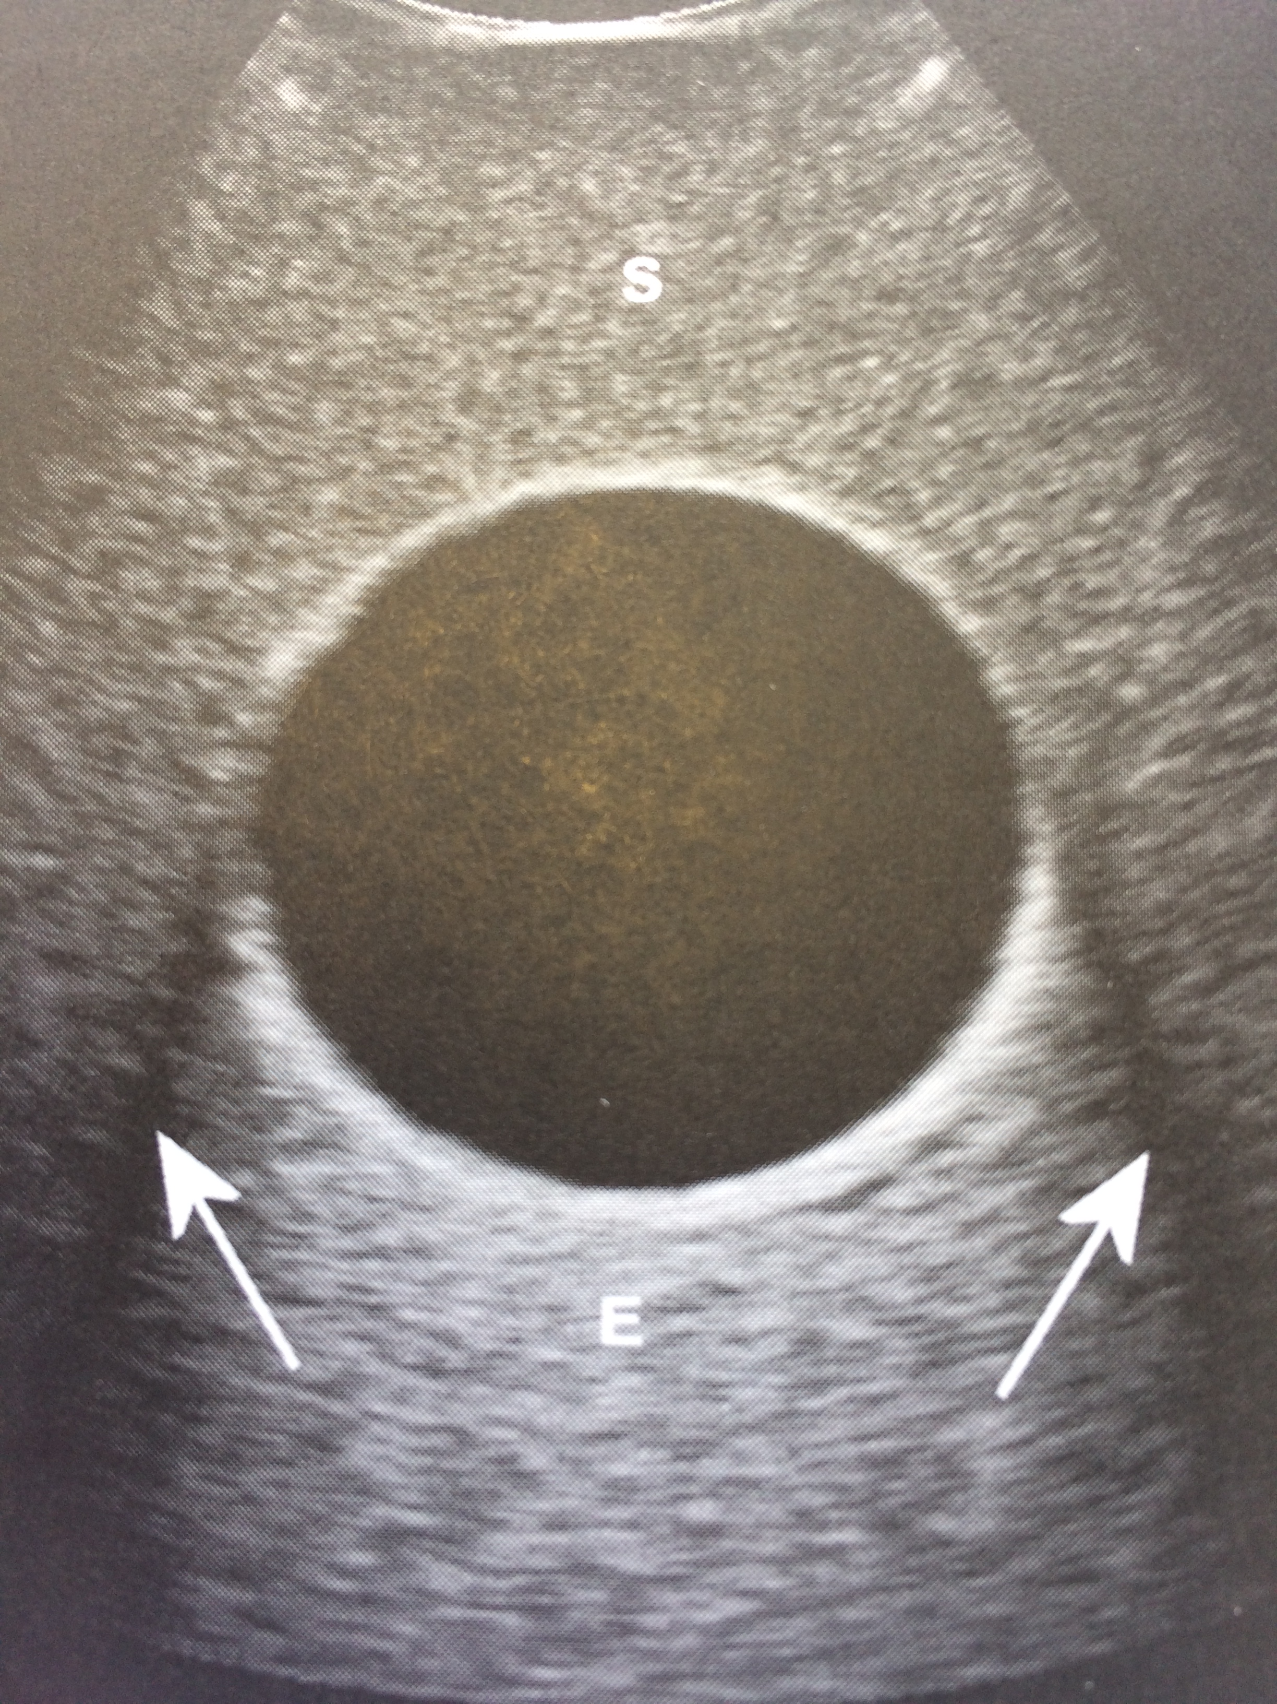
Speckles arises from ultrasound scattering
Speckle (S) adversely affects contrast.
Post-cystic enhancement (E) occurs when the TGC has been set up to compensate absorption in solid tissue but part of the field of view consists of a liquid region with low absorption. Good indicator of the presence of liquid!
Edge effect shadows (arrows) occur due to refraction at boundaries.
Notes:
Recall from lecture 1: The spatially random distribution of scatterers produces the familiar ultrasound speckle
There is no one-to-one correspondence between an individual speckle and individual scatterer
Individual scatterers are overlapping within a resolution cell
Targets in different cells can be resolved but those within a cell cannot, leading to interference to form a resultant signal that ay be weak or strong depending on the precise spatial distribution of the scatterers
Average axial and lateral speckle dimensions relate to the resolution, making speckle a characteristic of the scanner and probe rather than the tissue being imaged.
The structure of the tissue governs the average brightness of the speckle according to the strength of backscattering it produces

Slide 16
Compounding pulse-echo processes reduces speckle and other artefacts
Powers & Kremkau (2011) Interface Focus
Notes:
Spatial compounding averages sets of beams that are swept at different angles across the 2D plane of interest. The beams are angled by phased array steering techniques within the transmit and receive beamformers. Can be achieved in the frequency domain as well as the spatial domain for faster readout
Provides a more complete image of tissue boundaries
Also reduces the brightness of speckle by producing a smoother image as each set of angled beams results in a different spatial distribution of speckle, which when averaged together, produce overall a pattern with less variance in brightness.

Slide 17
Compounding pulse-echo processes reduces speckle and other artefacts
Powers & Kremkau (2011) Interface Focus

Slide 18
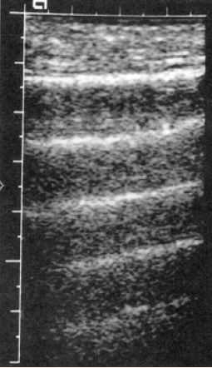
Reverberations can occur between the transducer and a strong reflector or parallel reflectors
Examples: anterior bladder wall, bowel.
Resulting image contains multiple echoes at regular spacings.
Positioned at n*d: multiples of the depth of the reflector.
Become gradually weaker with depth.

Slide 19
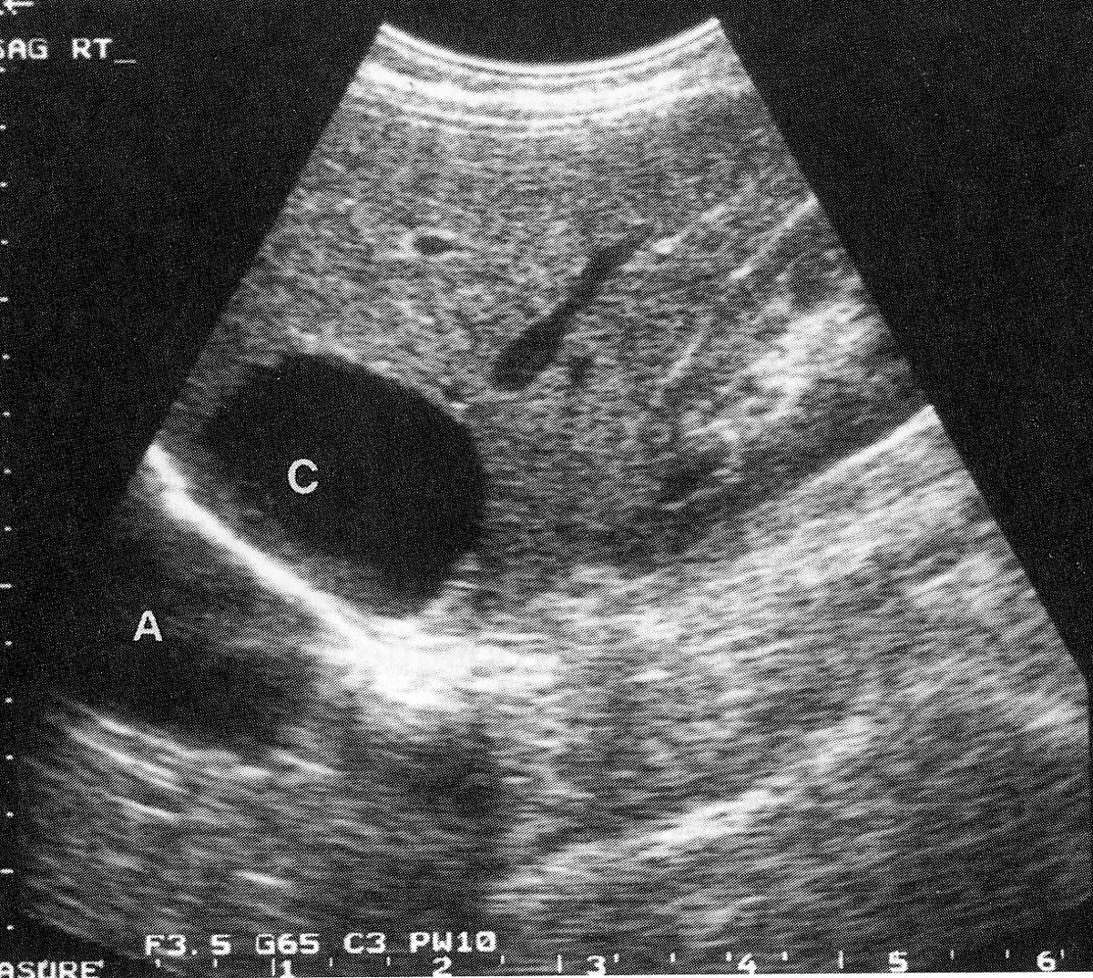
Reflection (mirror) artefacts from a strongly reflecting boundary
Example: diaphragm.
Echo producing targets on the near side of the boundary appear in their proper position, and as virtual images beyond the boundary.
The air backed diaphragm makes structures in the liver appear also in the lung.
Notes:
Some scattered echoes from the front of the cyst, C, return to the transducer and are placed correctly.
Other scattered echoes reach the diaphragm and are reflected back. They arrive later and are recorded as having come from much deeper, at the bottom of the artefact, A

Slide 20
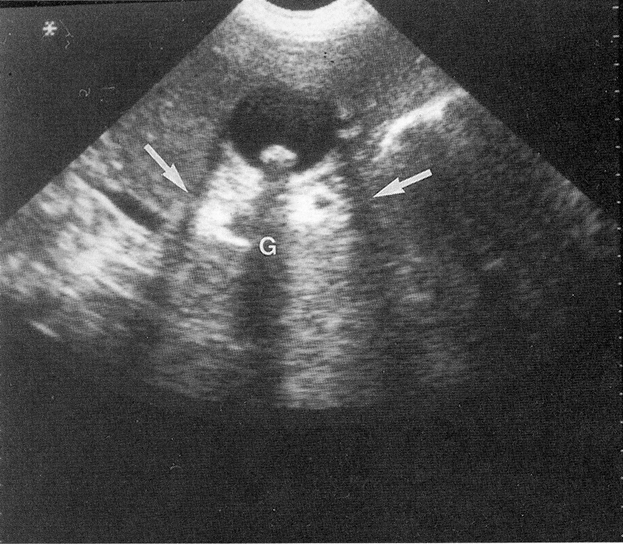
Refraction and attenuation artefacts arise from strongly reflecting and/or absorbing features
Example: gallstones.
Refraction artefact causes spatial distortion of the shape of the gallbladder at both edges.
Shadowing is seen behind the gallstone.
Enhancement is seen behind the fluid in the gallbladdder.
Notes:
Refraction artifact causes spatial distortion of the shape of the gallbladder due to the difference in the speed of sound between it and the surrounding tissue. not clinically useful, leads to imaging artifacts- double image artifact, incorrect localization of a structure on an ultrasound image.
Shadowing occurs because gall stones absorb more sound than the surrounding tissue so their presence helps to diagnose the presence of gall stones
Enhancement occurs when sound travels through a medium with lower attenuation than the surrounding tissue so reflectors at depth are abnormally bright under that medium

Slide 21
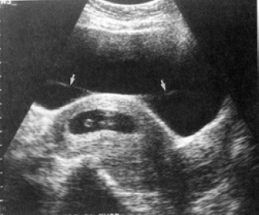
Side lobe artefacts come from high contrast objects that are located off-axis
Notes:
Strong reflecting surface generates ghost image data
Bright boundary continues out of the field, but the time of flight of the signals makes them appear as if they are on the image

Slide 22
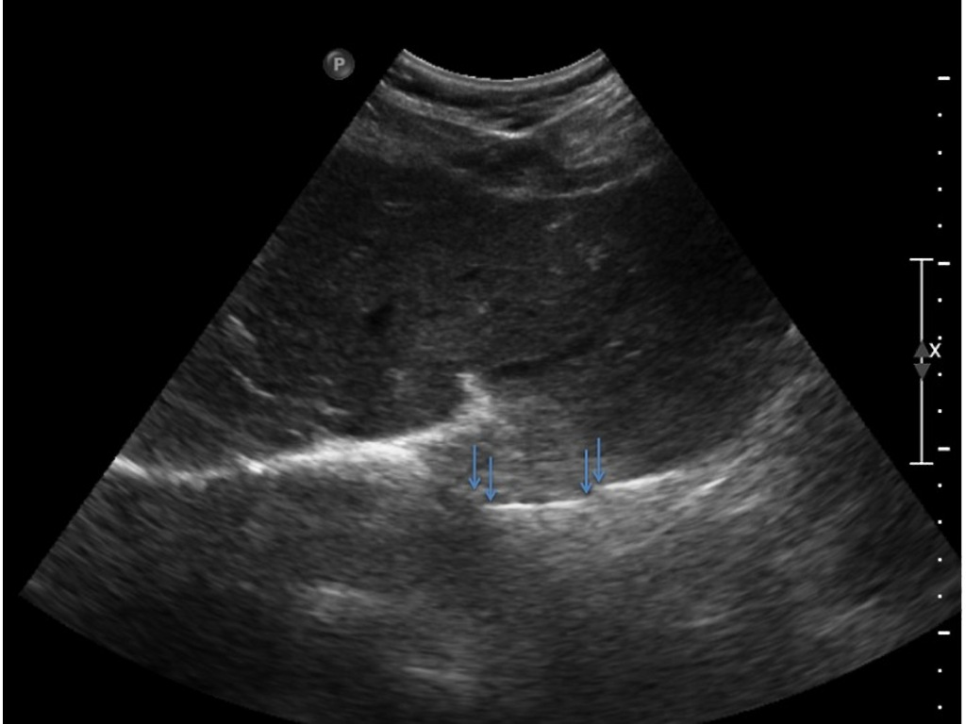
Speed of sound errors arise when speeds other than 1540 ms⁻¹ are encountered
Example: focal fat.
Ultrasound image processors assume that the sound has travelled at the same speed throughout the imaged anatomy.
Images are formed using the time of arrival of the pulse to determine the distance of the structure from the transducer.
Any slowing of the sound will lead to a discontinuity in a boundary and cause it to appear artificially deep
Case courtesy of Dr Francesco Priamo, Radiopaedia.org, rID: 31691

Slide 23
Resolution errors arise from the finite axial and lateral resolution of the ultrasound beam
Notes:
Recap from Lecture 1
If two reflectors are closer than half the spatial pulse length in depth, they appear as one reflector due to the focusing (axial resolution) of the ultrasound beam.
If two reflectors lying side-by-side receive the ultrasound pulse at the same time, they will appear as one reflector due to the width (lateral resolution) of the ultrasound beam

Slide 24
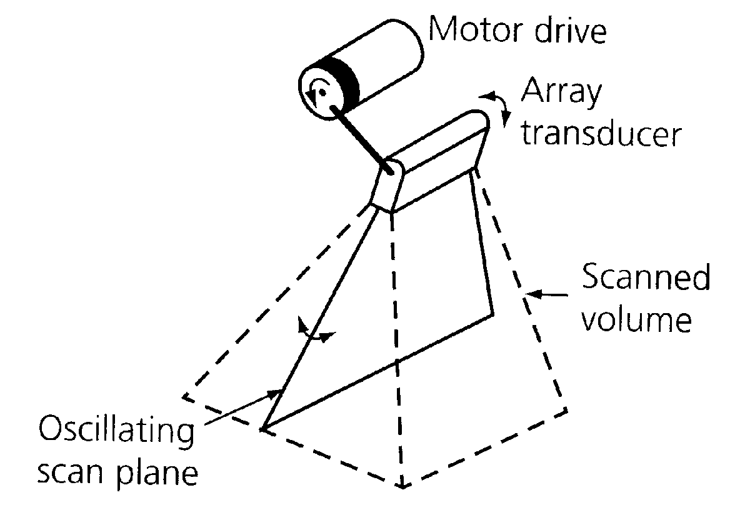
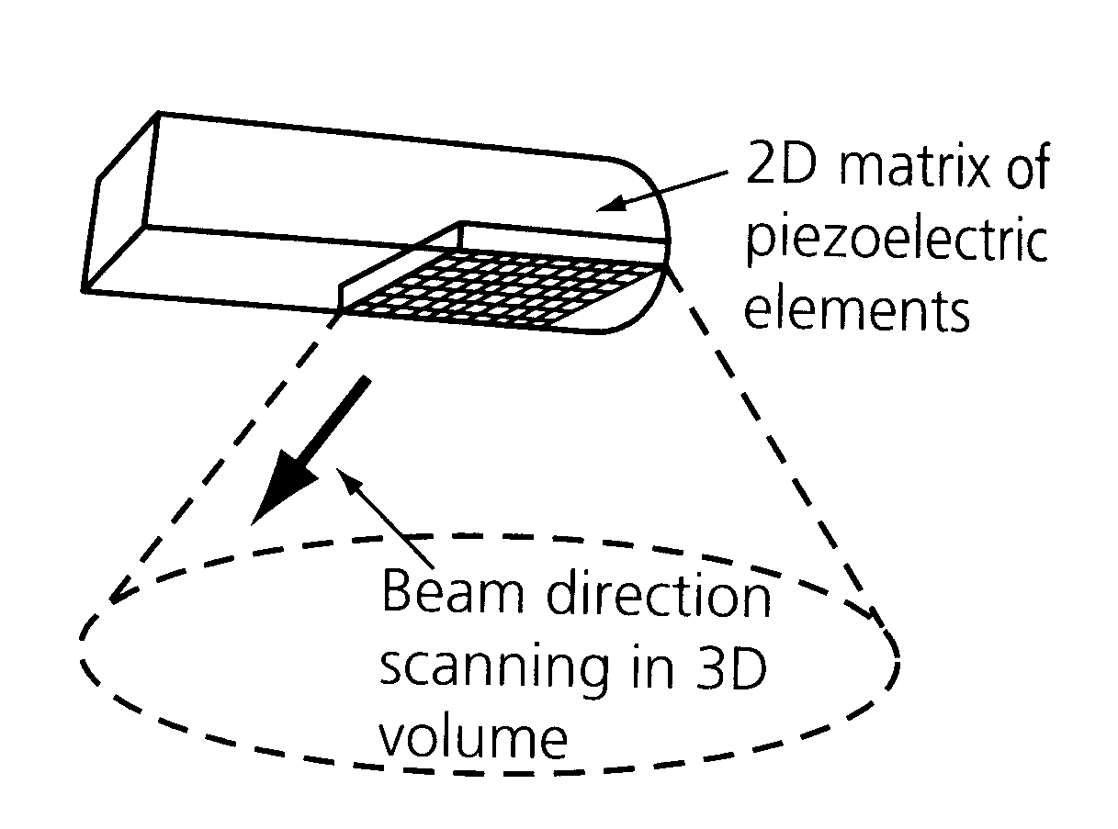
To create a 3D image you need to sweep a 2D plane through a volume of tissue
Notes:
This was originally achieved by freehand manipulation of the transducer over the region of interest
Mechanical drive tends to require bulky transducers
Phased arrays can direct a beam over a range of directions, but given the number of elements (typically 1000s), the volume of data is vast and a large amount of memory and processing power is needed

Slide 25
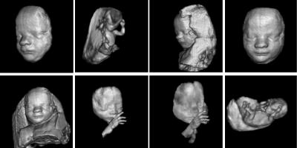
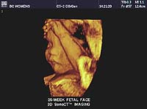
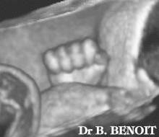
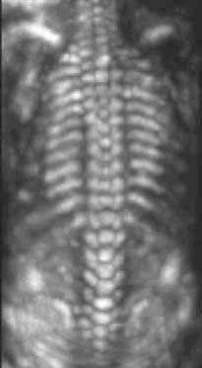
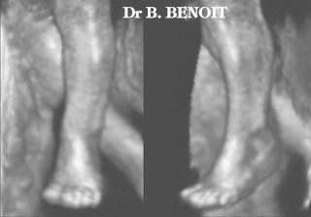
3D / 4D ultrasound

Slide 26
Summary: B-mode
Most commonly used ultrasound mode in clinical diagnosis.
Forms images based on pulse-echo technique, relying on impedance mismatches for contrast.
Assumes constant speed of sound and acoustic attenuation in tissue.
Suffers from a range of artefacts that must be identified and interpreted by the radiologist

Slide 27
Tissue harmonic imaging
Notes:
Many artefacts arise because the sound emitted from the transducer has to be of a strong intensity to make the echo from weakly backscattering features detectable despite attenuation along the pulse-echo path.

Slide 28
Ultrasound harmonics arise from non-linear propagation of sound in tissue
Pulse at 0 cm
Pulse at 10 cm
Tranquart et al (1999) Ultrasound Med Biol
Notes:
Harmonics are generated by the tissue as a result of propagation of the fundamental frequency generated during the transmit phase of the cycle.
At any instant, the peaks travel slightly faster than the troughs of the wave, because of the different velocity of ultrasound in compressed vs relaxed tissue.
This generates a very small amount of sound at different harmonics at any instant, but the cumulative harmonic intensity increases as the pulse propagates.
A very small amount of tissue harmonic is present at skin level, then increases with depth up to a point where tissue attenuation overcomes the build up and causes them to decrease.

Slide 29
Tissue harmonic imaging (THI) uses the ultrasound harmonics generated in tissue
Notes:
Fundamental echoes must pass through the body twice, whereas harmonics originate in the body and therefore are less subject to distortion from non‐linear propagation.
Higher frequency multiples of the interrogating frequency are called second (2fc) or third (3fc) harmonic frequencies.

Slide 30
Advantages of THI include reduced artefacts and improved spatial resolution
Uppal et al (2010) Australas J Ultrasound Med
Notes:
THI has several advances:
First, the signal-to–noise and contrast-to–noise ratios are improved. The primary cause of image noise and clutter is the composition of the body wall. Specifically, the amounts of fat, skin layer thickness and hydration level are some of the principal causes of ultrasound (US) beam distortion and scattering. In addition, lateral and slice thickness sidelobes (Christopher 1997; Rubin et al. 1998), as well as reverberation artefacts, also contribute to generate image clutter. This distorted and scattered energy is much weaker than the transmitted energy and, therefore, generates much weaker harmonics. As a result, tissue harmonic image contains minimal noise and clutter compared to fundamental imaging.
Second, the spatial resolution is improved. The narrowing of the width of the US beam improves the lateral resolution (Starritt et al. 1986). The decrease of the wavelength of the return harmonic signal compared to the fundamental improves the axial resolution.
Third, even though the penetration in harmonic mode remains lower than when using the fundamental mode because of the attenuation, the visualization of deep structures is frequently improved. The use of tissue harmonics generated from even lower fundamental frequencies (1 MHz) could further improve the visualization of tissue at depth.

Slide 31
Modern transducers have wide bandwidth so can be tuned to receive echoes at higher harmonics
Transmitted
Amplitude
Frequency
Radial distance
f₀
Received
Amplitude
Frequency
f₀
2f₀
~ 6cm
Depth
Notes:
Sound consisting of a fundamental band of frequencies is transmitted into the patient; no harmonics exist in this waveform
Non-linear propagation means that the pulsed waveform becomes distorted as it passes through tissue
The distorted waveform contains both the fundamental frequencies and also higher harmonics. The second harmonic is of greatest interest as the higher harmonics tend to be too weak to be useful.
Harmonic energy is concentrated in the centre of the transmitted beam, where the sound energy is highest in amplitude, meaning side lobes are fewer
There is also relatively little harmonic generation in the very near field because the beam is not sufficiently focused to be of a high enough intensity. This can improve depth of penetration, as at usual imaging distances harmonic signals can be larger than the fundamental. Improves lateral resolution

Slide 32
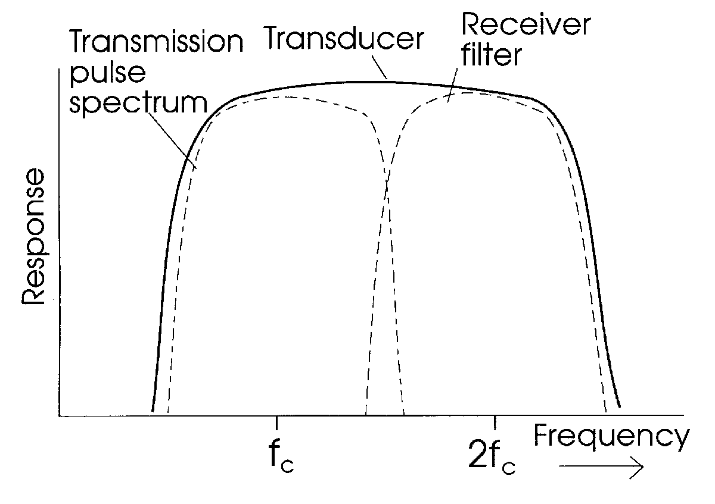
Modern transducers have wide bandwidth so can be tuned to receive echoes at higher harmonics
Notes:
Tissue harmonic images are formed by utilising the harmonic signals that are generated by tissue and by filtering out the fundamental echo signals that are generated by the transmitted acoustic energy.

Slide 33
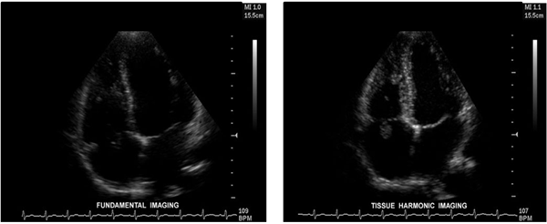
Improved visualisation: Imaging endocardial borders
Fundamental
THI
http://www.escardio.org
Notes:
example of improved visualization of endocardial borders when using THI (heart). ventricles appear uniformly dark, contrasting with tissue which appears bright. improved resolution and depth of imaging

Slide 34
Summary: THI
Improves axial resolution due to higher frequencies and lateral resolution due to narrower beams.
Fewer artefacts from reverberations and side lobes but often more shadowing.
Can lead to better lesion visibility in patients with high BMI, or in highly echogenic tissues such as fat, bone or air.
Improves imaging of liver, gallbladder, pancreas, kidneys etc.

Slide 35
Doppler

Slide 36
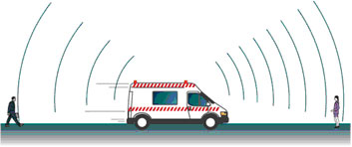
The Doppler effect can be exploited in ultrasound to detect, image and quantify flow
The Doppler frequency shift enables us to calculate scatterer velocity v:
t = denotes transmit, r denotes receive
f_{d} = f_{t} – f_{r} is the Doppler frequency shift
v = scatterer velocity
θ = angle between the ultrasound beam and flow direction
c = speed of sound in tissue
NB no Doppler shift at θ=90
Notes:
In the absence of movement, the observed frequency of sound is the same as the transmitted frequency.
If the sound source moves towards the observer, such as the ambulance towards the lady in this picture, each wavefront is emitted from a location closer to the observer so the wavelength appears shorter and the observed frequency is higher.
When the source moves away, as from the perspective of the man, the opposite is true, with the observed frequency appearing lower.
The expression is multiplied by 2 because the Doppler effect occurs twice – when the original wave is incident on the moving particle and when the moving particle reflects it back, hence acting now as a moving source of ultrasound.
v cos theta accounts for the angle between the ultrasound beam and the flow, as the change in frequency is caused by the component of the particle velocity in the direction of ultrasound propagation, rather than its true velocity
Cos theta = 1 if parallel and = 0 if perpendicular. in contrast to traditional echo, which is maximum for perpendicular geometry. Significant limitation for Doppler ultrasound as the angle must be known to extract the true velocity of blood

Slide 37
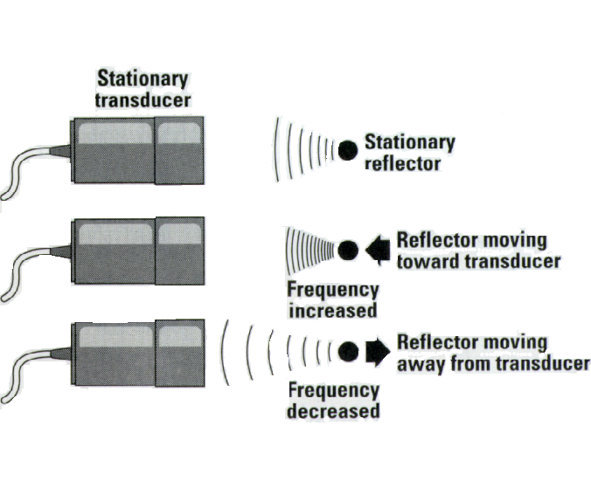
In a pulse-echo system, waves reflected or back-scattered from moving features shift in frequency
Notes:
The same physics applies at ultrasound frequencies. In medical ultrasound, a stationary transducer transmits the wave and a moving reflector - a group of red blood cells (RBCs) - acting as the observer will see a frequency shifted by the Doppler effect.
The RBCs now act as the source by scattering this shifted frequency back to a stationary, receiving transducer. There is relative motion between the RBCs and the receiver, and so there is another Doppler shift. The second shift is in the same direction as the first, and so the difference between the transmitted and received frequencies is a double Doppler shift.
Doppler systems are typically used to display blood flow, hence rearranging the equation to have v on the left hand side
Convention: velocity positive when scatterer moving towards the sound source, yielding a positive Doppler shift
As the Doppler shift is proportional to the transmitted frequency, which is usually in the range up to 20MHz max, there is a trade off between attenuation and increasing Doppler signal.

Slide 38
Continuous Wave (CW) Doppler is the simplest approach
A continuous sinusoidal wave is transmitted with one piezo element and the reflected wave is received with a second piezo element
Narrow ultrasound bandwidth means high sensitivity and accuracy
But: No imaging
Receiving element
Transmitting element
Sensitive volume
Flow
Notes:
Achieves the high velocities needed for a range of cardiac applications
Lacks selectivity of depth because the transducer is constantly transmitting / receiving so the output includes shift data from every red cell along the course of the beam (is now possible to use a phased array to perform 2D B mode with CW).
Focal volume can be defined by offset of the two transducers, creating an intersection volume of transmitted and received zones.
The PZT elements do not need to be damped as the overlap of their ultrasound beams determines resolution, so can achieve high sensitivity with a narrow bandwidth of ultrasound.

Slide 39
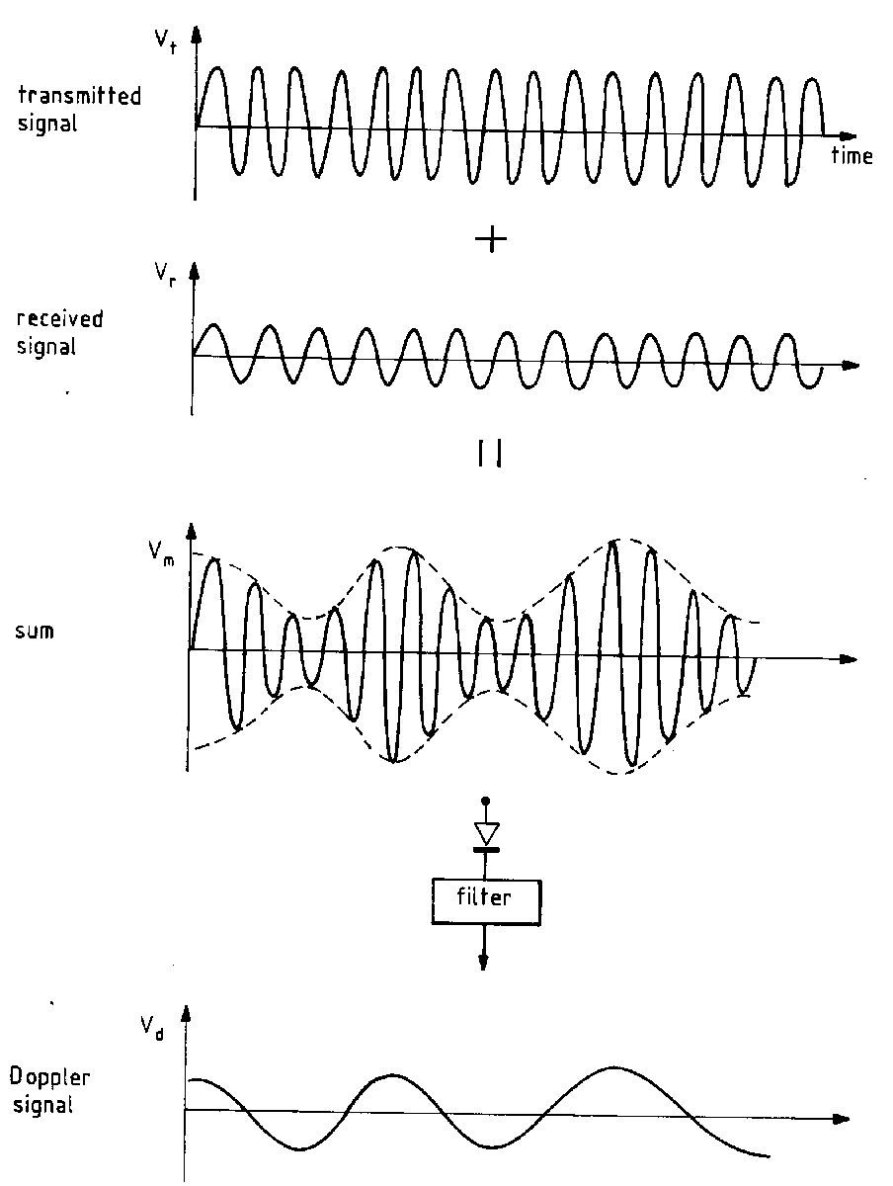
CW Doppler data are analysed by demodulation
Notes:
One method of demodulation is the summation of the reference (transmitted) signal and the received signal.
The result is a beat frequency which equals the Doppler shift frequency.
This waveform is filtered to extract the Doppler shift frequency.
This simple processing will give the size but not the direction of the Doppler shift frequency.
To obtain the direction the received signal is split into two paths. One path undergoes a 90º phase shift, before each passes into its own demodulator. Both signals are then combined - quadrature phase detection.
Other moving structures e.g. vessel walls, will give rise to Doppler signals, though as their frequency is typically lower, the demodulated signal can be passed through a high-pass filter to remove them… disadvantage is that signals from slow moving RBCs are also lost.

Slide 40
Pulsed Wave (PW) acquisition enables Doppler imaging
A single transducer alternates between transmit and receive functions
PW transmitted at a constant pulse repetition frequency to enable localization by range gating
But:
  Lower sensitivity as wider band signals than CW
  Less accurate for high blood flow due to signal aliasing
Transmitting & receiving element
Gate depth
Gate length
Sensitive volume
Flow
Notes:
Can provide Doppler data from a small sample volume by range gating, defined by pulse repetition frequency.
Doppler pulse typically longer than a B-mode pulse (4-10 cycles, smaller bandwidth but still broad compared to CW so lower SNR).
Several pulses are sent along the scan line and received echoes are mixed with the reference signal. Each echo from a different reflector will return at a slightly different time, hence phase shift will affect interference sum. The demodulated signals are equivalent to samples of the continuous wave beat frequency. Therefore, less accurate for high blood flow due to aliasing (velocity exceeds sample rate of pulsed system, less aliasing in low frequency transducer systems).
Phased arrays allow us to build up images.

Slide 41
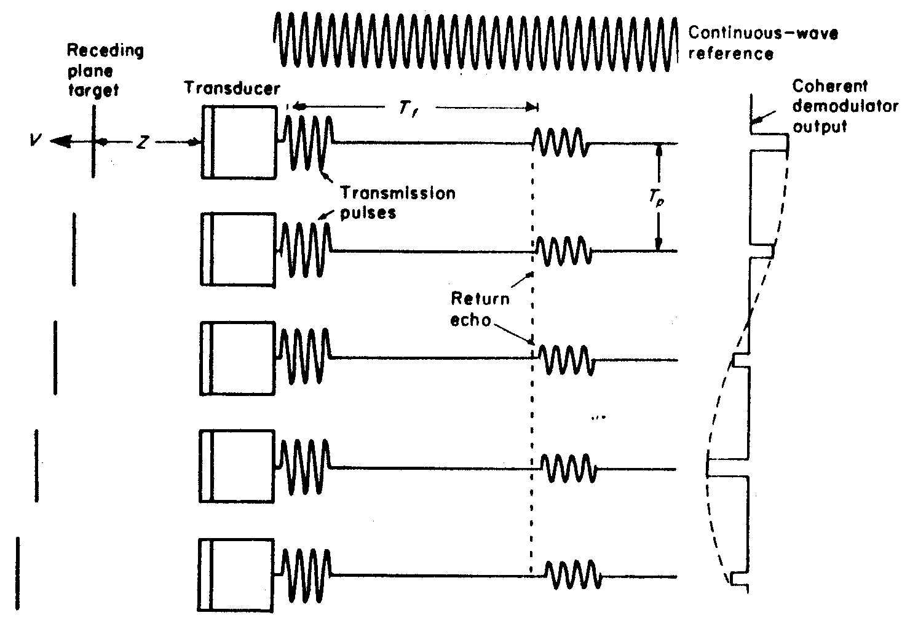
PW Doppler receive signals are not continuous nor of a single frequency
Demodulated signals are equivalent to samples of the continuous wave beat frequency.
Notes:
Several pulses are sent along the scan line.
The received echoes are mixed with the reference signal.
Each echo from a moving reflector will return at a slightly different time, relative to the transmitted pulse, from the previous one, and will be in slightly different phase with the reference signal, thereby affecting the size of the interference sum.
The broadband of frequencies contained in the pulse are all subject to Doppler shifts

Slide 42
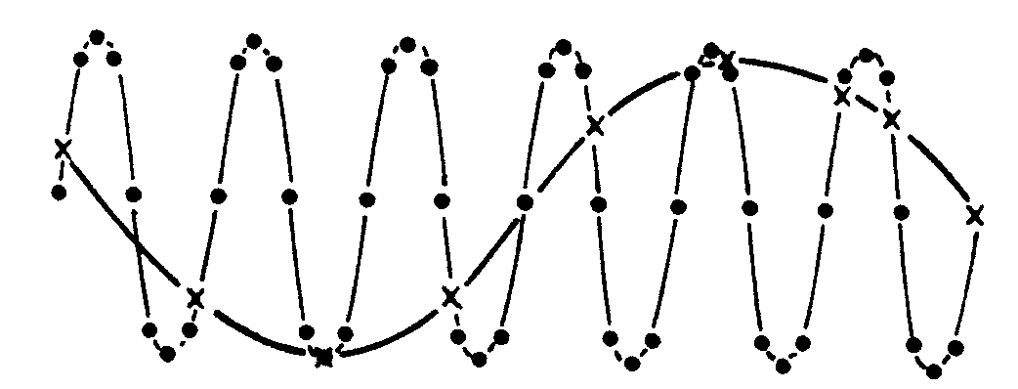
Too few samples of the PW Doppler signal leads to aliasing artefacts
Signals must be sampled at least twice per cycle of the highest frequency component “Nyquist limit” to avoid aliasing
The maximum Doppler shift frequency that can be detected is half the pulse repetition frequency (rate of ultrasound pulse transmission), which is typically 10 kHz
Notes:
The more samples that are obtained the better the determination of the beat pattern.
Conversely, the beat frequency will be incorrectly determined if there are too few samples, leading to an artefact called aliasing.
When a high frequency wave is sampled adequately (dots) the frequency is preserved.
If the sampling rate is too low (x) the beat frequency will be misinterpreted as a waveform with a lower frequency - aliasing.
This is analogous to the effect seen in films where wagon wheels appear to be going backwards due to the low frame rate of the film

Slide 43
Comparison of CW and PW Doppler
 | Disadvantages | Advantages
Continuous Wave | Lacks range resolution | Accurately measures high velocity flows
Pulsed wave | Aliasing of velocities above the Nyquist limit (inability to measure high velocities accurately) | Ability to measure velocities at a specific location (range resolution) to provide image data

Slide 44
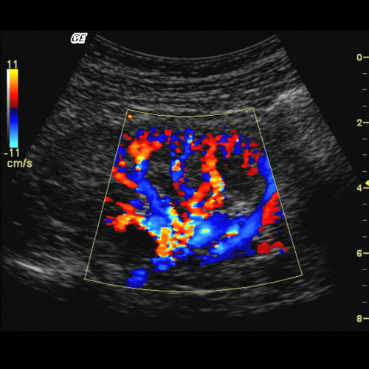
Colour Doppler allows the overlay of a velocity map on a gray-scale B-mode image
Colour flow
  Doppler equivalent of a B-mode scan, using several pulses transmitted and received along each line
  Uses gated, pulsed wave Doppler mode
  Calculates phase shift between subsequent pulses
  Colour is chosen based on mean velocity and direction
  Velocity information in colour (red, flow towards; blue, flow away) is superimposed on the anatomical gray scale B mode image
Notes:
The echoes are analysed for amplitude, and phase or time. Stationary structures are assigned a grey scale as in B-mode. If motion is detected, the mean Doppler shift frequency and its variance, and its direction are calculated.
Within each time gate, echoes from a moving target change in phase from pulse to pulse - the rate of change of phase being proportional to the velocity.
Successive echoes are compared with each other using a method called auto-correlation to extract the mean Doppler shift frequency.

Slide 45
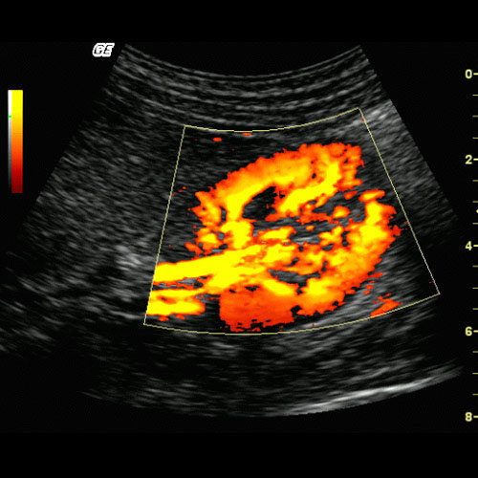
Power Doppler displays the intensity of the Doppler backscattered signal in colour
Power
  Ignores the reflector velocity information and estimates the total strength of the Doppler signal within a region
  Improves sensitivity in small vessels and is a good indicator of blood volume
  Independent of flow direction
  Lack of aliasing and reduced angle dependence make imaging easier
But
  Qualitative
  No velocity or direction information can lead to motion artifacts

Slide 46
Summary: Doppler
The Doppler effect can be exploited in ultrasound to detect, image and quantify flow.
Continuous wave Doppler provides high sensitivity velocity measurement at a defined point.
Pulsed wave Doppler enables imaging but suffers aliasing and spectral broadening artifacts.
Colour Doppler provides visualisation of velocity information, while Power Doppler shows only Doppler signal intensity, so is less prone to artefacts.

Slide 47
Ultrasound Applications
Ultrasound Safety and Standardisation

Slide 48
Diagnostic ultrasound has an excellent safety record
In England alone >2.5 million obstetric ultrasound scans are performed every year (~4 per live birth)
Exposure of tissue to ultrasound can produce hazardous effects at diagnostic acoustic output levels, particularly for foetal exposures.
Main categories of hazard include:
  Thermal
  Non-thermal (cavitation and mechanical force)
The safe use of diagnostic ultrasound is the responsibility of the person conducting the scan!
  The examination should only be undertaken if the benefits to the patient outweigh the costs associated with the potential hazard
  American Institute for Ultrasound in Medicine (AIUM): “the benefits to patients of the prudent use of diagnostic ultrasound outweigh the risks, if any, that may be present”

Slide 49
ALARA (As Low As Reasonably Achievable) principles should be applied above effect thresholds
Use minimum output needed to obtain necessary diagnostic information (BMUS)
Need to monitor the exposure during the scan
Many variables affect the exposure:
  Operation mode (B-mode vs Doppler)
  Transducers (frequency, focus)
  System setup (presets, output powers)
  Pulse repetition frequency
Displays are designed to make the user aware of exposure:
  Thermal index and mechanical index can be used to indicate potential harm due to each of these mechanisms
  If the system is capable of exceeding TI or MI = 1.0, then operation should be kept below 0.4.

Slide 50
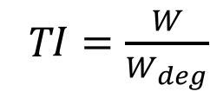
The Thermal Index (TI) is an indicator of the likely maximum temperature rise in tissue
Current acoustic output power from the transducer during use
Thermal Index
Easily interpreted as a TI of 2 means a temperature rise of 2°C
T$I=\frac{W}{W_{deg}}$
Acoustic output power required to raise the temperature by 1°C anywhere in the beam using identical scanner settings
Notes:
Ignores self-heating of the transducer so greatly underestimates the temperature in the first 5 mm of the transducer
Range of normal temperatures 36-38°C
Moderate temperature increases may arrest or retard cell division
Teratogenic effects above 40°C, enzymes denatured >45°C
A diagnostic exposure with a maximum temperature rise of 1.5°C does not appear to present a risk if limited to under 30 min
Particular risks in:
The eye, where blood supply is poor so heat cannot be easily dissipated
Neural cells
Bone/soft tissue interfaces
The developing embryo and foetus (particularly as bone becomes denser)
In risky cases, exposure limits are defined
A threshold dose of 0.5 min exposure to a 4°C increase above normal temperature is considered hazardous to embryonic & foetal development
In later pregnancy, heated volume is small compared to size of foetus making biological effects difficult to detect (prudent to minimise output)

Slide 51
Axial profiles show significant temperature increases close to the tissue surface
http://www.brl.uiuc.edu/Publications/1994/O%27Brien-BookChap-317-1994.pdf
Notes:
Maximum temperature rise is normally within the first cm or two of the surface for scanned mode conditions

Slide 52
Axial profiles show significant temperature increases close to the tissue surface
http://www.brl.uiuc.edu/Publications/1994/O%27Brien-BookChap-317-1994.pdf
Notes:
Left figure shows the difference in temperature profile for large aperture (>1cm2, top) and small aperture (bottom).
The diagnostic ultrasound system will know which transducer is in use at any one time and make the appropriate calculation internally
Right figure shows typical axial temperature increase for the bone and focus in unscanned mode, with maximum temperature increase occuring at the bone

Slide 53
TI is limited by several simplifying assumptions
Assumes tissue attenuation is 0.3dBcm-1MHz-1
Assumes for bone a fixed proportion of the incident power is absorbed in the bone layer
Does not account for non-linear propagation
Ignores transducer self-heating
Thermal image showing heat flow into the transducer body after 200s
Notes:
Heating depends on the ability of the tissue to absorb, rather than reflect or scatter ultrasound – more dense tissue typically have higher absorption coefficients (e.g. bone up to 50-fold that of soft tissue)
True temperature rise may be a factor of 2 or 3 greater than that displayed

Slide 54
Acoustic cavitation occurs when bubbles are driven by an ultrasound beam
Notes:
Non-thermal effects can also arise that lead to mechanical damage
Bubbles can respond to acoustic energy by cavitation
Non-inertial (stable) cavitation occurs at low peak values of acoustic pressure. Requires continuous wave ultrasound
Inertial (transient) cavitation occurs as gas bubbles in a liquid can be driven to change in size, expanding during the period of rarefaction (decreased pressure) and contracting during compression (the period of increased pressure). Occurs when the surrounding medium inertia controls bubble motion. As the peak acoustic pressure increases, the bubble becomes unstable as it contracts, collapsing catastrophically under the inertia of the surrounding liquid.
Bio-effects of acoustic cavitation arise from shear forces, between the bubble and any adjacent surface, or the bubble and its neighbours. Shear forces can damage cell membranes. Fluid flow immediately around the bubble can subject cells to a high velocity gradient.
Bio-effects can also arise from very high instantaneous temperatures within the bubble that can cause free radical formation.
Bubble fragments can nucleate further bubbles

Slide 55
The Mechanical Index (MI) indicates the probability of occurrence of inertial cavitation
Mechanical index. Based on a model that assumes the presence of bubble nuclei in tissue, which predicts that inertial cavitation is more likely at lower frequencies and higher values of peak rarefaction pressure.
MI < 0.7 indicates conditions for inertial cavitation probably do not exist.
Maximum value of derated** peak rarefaction pressure in the beam (MPa)
-> Measured by recording p at a range of depths (p_{r}) and derating the values to find the maximum value of p_{r,0.3}
$$MI=\frac{p_{r,0.3}}{\sqrt{f}}$$
Centre frequency in the pulse (MHz)
**NB Normal measurements of acoustic pressure are made in water (“free-field”), which has almost no attenuation. To estimate pressure in soft tissue for the same ultrasound beam, values are “derated” by an amount dependent on tissue attenuation, normally 0.3 dBcm⁻¹MHz⁻¹.
Notes:
Adopted in the output display standard
Cavitation depends on centre frequency, pulse repetition frequency, pulse duration, tissue properties (density, viscosity, elasticity) and the size of the cavitation nuclei (initiating gas bodies)
MI is based on a theoretical examination of the bubble collapse temperatures that could achieve 5000K, at which free-radical generation can occur.
MI is roughly proportional to the mechanical work that can be performed on a bubble in the rarefactional phase of the acoustic field
Valid under conditions for onset of inertial cavitation

Slide 56
Summary: Safety
Thermal effects must be carefully considered
  Bone heats preferentially and will warm surrounding tissues
Tissues next to a gas boundary are particularly vulnerable to mechanical damage
  Cavitation is unlikely in diagnostic ultrasound except in fluid and air filled volumes, which may cause mechanical trauma to adjacent soft tissue
The thermal and mechanical indices provide an output display standard for assessing risks of adverse bio-effects in a given scan
These indices should be as low as possible to record diagnostic information

Slide 57
Ultrasound Applications
Ultrasound Safety and Standardisation

Slide 58
Supplementary Slides
Non-examinable, just included for interest

Slide 59
Example: what Doppler shift is expected under standard imaging conditions?
Ultrasound frequency 10 MHz
Speed of sound 1540ms⁻¹
Scatterer velocity 30cms⁻¹
Angle of 45 degrees
Notes:
(2*10000000*0.3*sqrt(2)/2) / 1540 = a frequency of 2.75kHz
Since this frequency is audible, a simple hand-held indicator ca be used to present Doppler signals to the operator via a loudspeaker

Slide 60
Contrast agents

Slide 61
Using contrast agents provide additional harmonics for imaging
Contrast agents are used to enhance ultrasound signals and can include both free gas bubbles (e.g. Echovist) and encapsulated gas microbubbles (e.g. Levovist)
Contrast agent harmonics are generated by reflections from the injected contrast agent and rather than from reflections from tissue
For example, gas microbubbles resonate when subjected to ultrasound, producing fundamental and harmonic frequencies
The resonance frequency of gas bubbles is similar to that of ultrasound, leading to a signal enhancement of around 1000-fold

Slide 62
The resonance behaviour of the bubbles is non-linear
Pressure | Response
<0.05MPa | Bubble resonates linearly
0.1MPa | Bubble oscillates non-linearly so higher harmonics are present in the scattered frequency spectrum
>1 MPa | Bubble is destroyed
Notes:
Free gas bubbles resonate more strongly than encapsulated ones but dissolve quickly giving only transient imaging

Slide 63
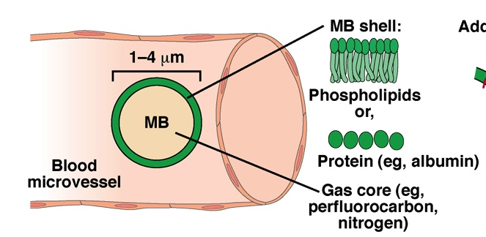
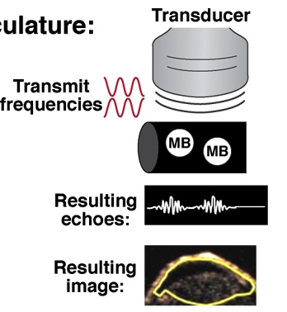
Microbubbles provide strong ultrasound contrast so can be used for both imaging and therapy
FDA-Approved MBs | Shell Comp. | Gas Core
Optison (GE) | Albumin | Octafluoro-propane
Levovist (Shering/Bayer) | Lipid/Galactose | Air
Definity (BMS) | Lipid | Octafluoro-propane
Pysz and Willmann. 2011 Gastroenterology 140(3):785.
Notes:
Gas filling enables high reflection and scatter of sound in blood (because of their micron size they are usually confined to the vasculature). Takes advantage of the fact that microbubbles compress and expand to produce nonlinear scattering of sound to harmonic frequencies above or below the fundamental frequency. This means we can benefit from the aforementioned advantages of tissue harmonic imaging with the added benefit of sensitive detection of microbubbles and suppressed background.
Usually filled with perfluorocarbon gases that are heavier than air (for stability reasons). Generally safe and low toxicity compared to CT and MRI contrast agents. Although not standard of care in clinical use, their popularity has grown significantly in recent years.

Slide 64
Measurement of microbubble influx and efflux can give a quantitative measure of tissue perfusion
Notes:
Functional Imaging: Measure Vascularity using perfusion of microbubbles. One simple analysis method is illustrated here. Time Intensity Curve (TIC) gives MB Wash-in/Wash-out Kinetics
Other analysis methods include Maximum Intensity Persistence (MIP), where the accumulation of MB → Vascular Map. Plus Destruction-Replenishment (Re-perfusion) where the perfusion measurement is performed after steady-state has been established, to avoid complications due to differences in bubble injection speed and volume.

Slide 65
Measurement of microbubble influx and efflux can give a quantitative measure of tissue perfusion

Slide 66
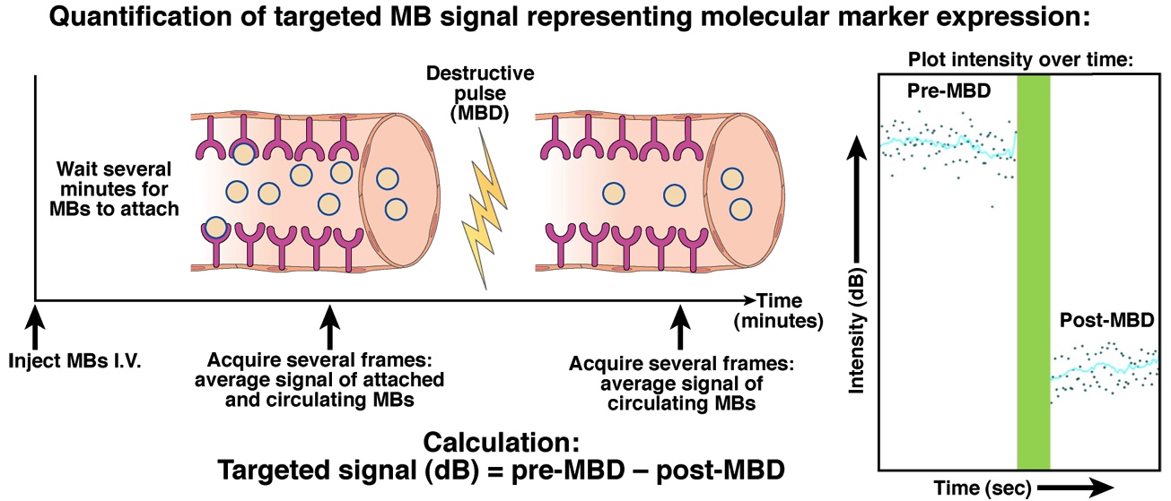
Targeting microbubbles to specific disease markers enables delivery of large volumes of toxic drugs
“Theranostic”
Notes:
Molecular Imaging: Measure Vascular Marker Expression - MBs Bind to Receptors on Luminal Surface

Slide 67
Summary: Contrast agents
Contrast agents can provide functional and molecular imaging signals
Encapsulated microbubbles can be used in a destruction-reperfusion mode to quantify:
  Wash-in and wash-out kinetics
  Receptor expression

